Slide 1
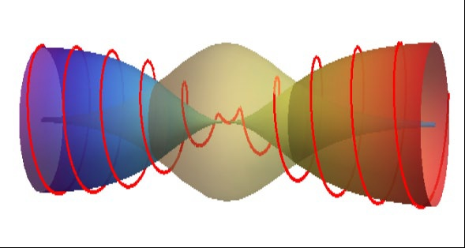
Lecture 4.
Solitons – part II
Solitons in frame of charge order
1D systems with continuous symmetries
Incommensurate CDWs
Crossover to higher dimensions
Phase transitions in the ensemble of solitons

Slide 2
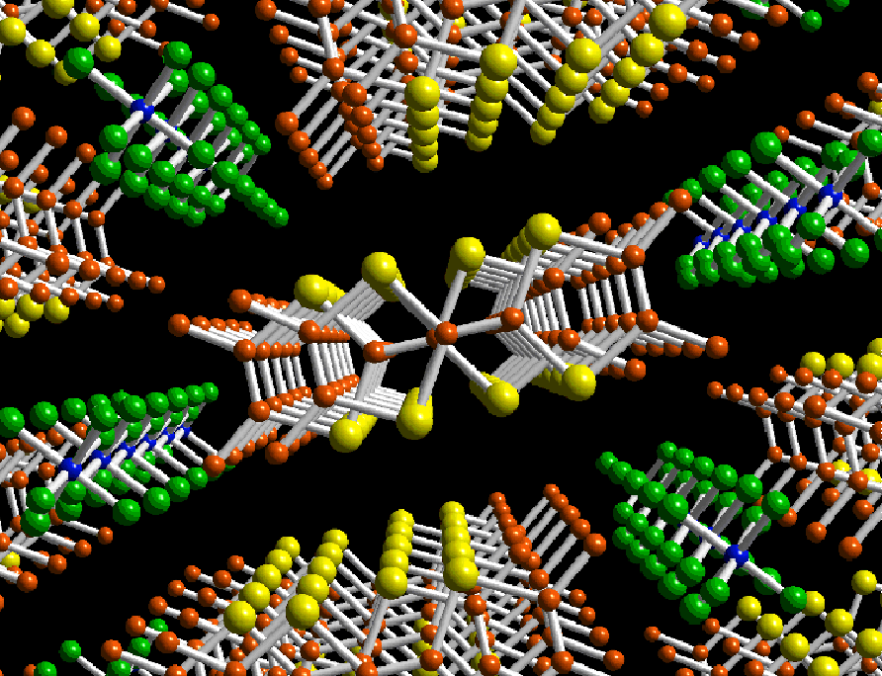
Family of the first ever organic superconductor 1980
(TMTCF)₂X C=S,Se ; X=PF6, …. , Br - acceptors

Slide 3
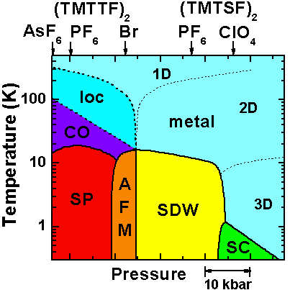
The ever richest phase diagram of electronic phases.
H
CO – Charge Ordering
AFM – Anti-FerroMagnetism
SDW – Spin Density Wave
SP – Spin-Peierls
SC – Superconductivity
H axes – field-induced density waves,
quantum Hall, oscillating cascades

Slide 4
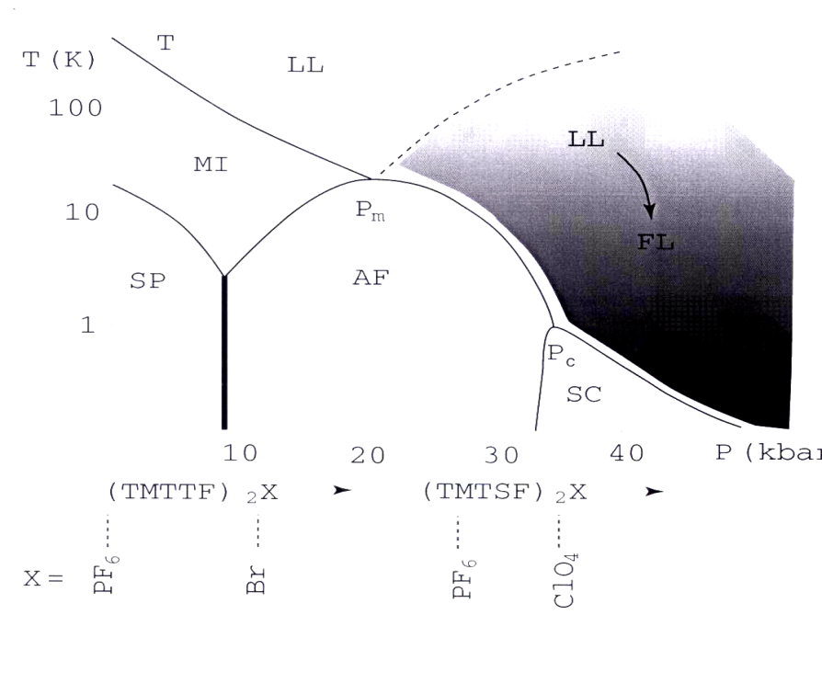
T_{c} =230K - 30K
Gaps from activation or optics:
2000K (ReO₄) , 600K (Br) ,
500K – (TMTSF)₂X !
SC- superconductivity;
AF= AFM = SDW; SP- Spin-Peierls;
MI- Mott insulator; LL- Luttinger liquid
Red lines 2000’s revaluation:
Structurless transitions (Coulon et al 1985) = Ferroelectricity
(Monceau, Nad, S.B.)
= Charge disproportionation (Brown)
Log scale of T !
Views and interpretations:
FerroElectric Mott-Hubbard state (SB)
mixed site/bond 4K_{F} CDW (Pouget)
pinned Wigner crystal ( Kanoda)
charge ordering (Brown)
Workshop for Solitons (SB) -
3 different types identified:
spinless phase solitons,
spinless polarisation solitons,
spin+charge reconfined solitons
Major enigma:
continuation of the Charge Order and Ferroelectricity into the metallic
and even superconducting state :
strong evidences for the related optical gap – Degeorgi & Dressel groups.

Slide 5
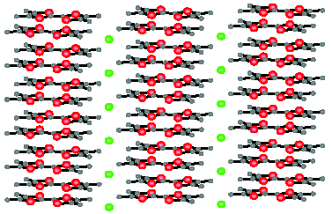
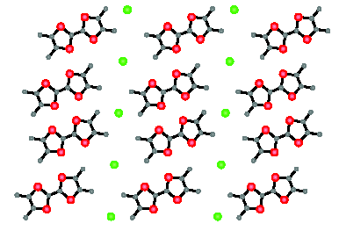
conterion
= dopant X
Molecule
TMTTF
or TMTSF
Built-in dimerization of bonds –
counterions against each second pair of molecules )
Spontaneous symmetry breaking seen by displacements of counterions:
nonequivqlence of sites
Arrows show displacements of ions X.
They follow and stabilize the electronic
charge disproportionation.
Collinear arrows – ferroelectricity.
Alternating arrows – anti-ferroelectricity.
A single stack is polarized in any case.
Major polarization comes from redistribution of electronic density,

Slide 6
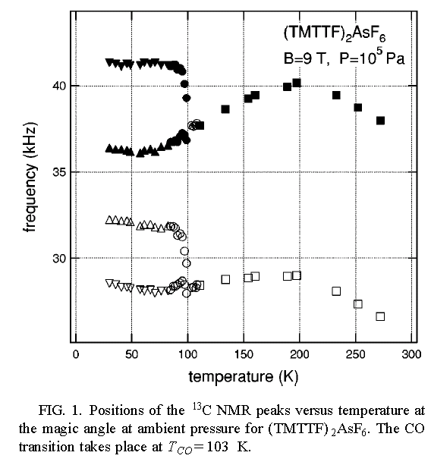
Indications for the charge disproportionation:
Two inequivalent molecular sites.
NMR: S.E.Brown
group, UCLA
Recall K. Kanoda 1998
Dumm et al, Stuttgardt
M Dressel group

Slide 7
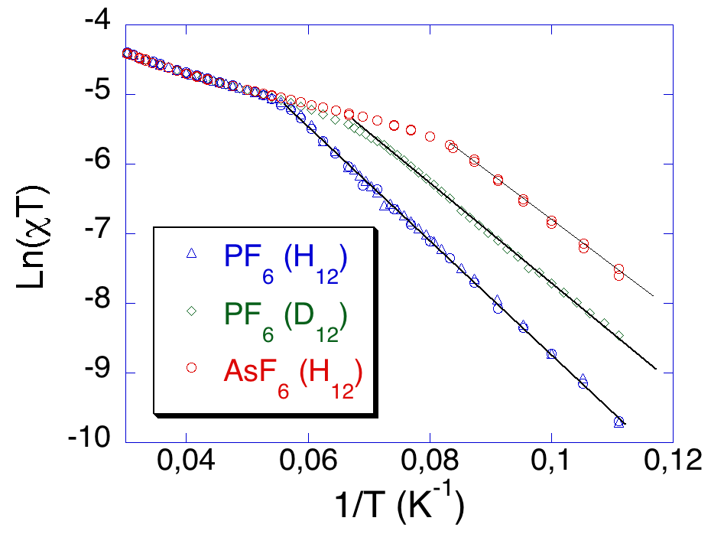
Organic conductors: low scales of gaps allow for their determination
from thermal activation and comparison with optical features.
What does conduct in these “narrow gap semiconductors” ? NOT the electrons, even in the polaronic version !
PF6
AsF6
SbF6
Conductance , normalized to RT
- Ahrenius plot LogG(1/T).
Gaps Δ_{c} for thermal activation of
conductance within 500-2000K.
χ∼exp(-Δ_{s} /T) , Δ_{s} ∼75Κ
Contrarily to normal semiconductors –
NO GAP, or a very small gap Δ_{s},
in spin susceptibility χ(T).
Clearlest example for conduction by
charged spinless solitons - holons.

Slide 8
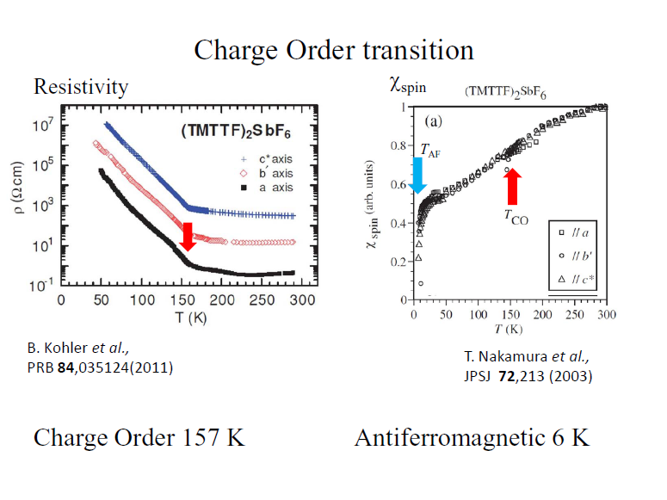

Slide 9
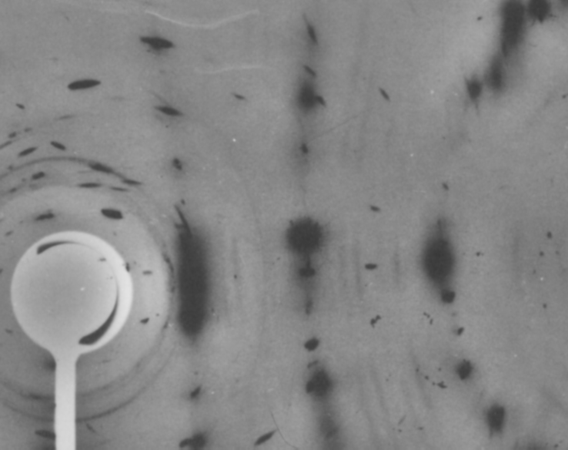
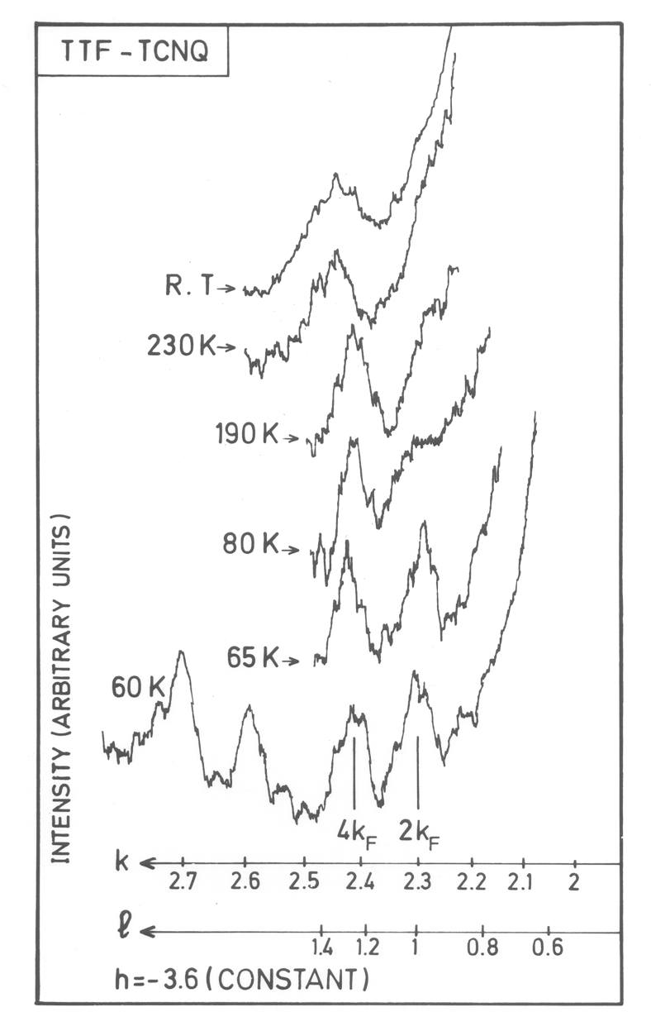
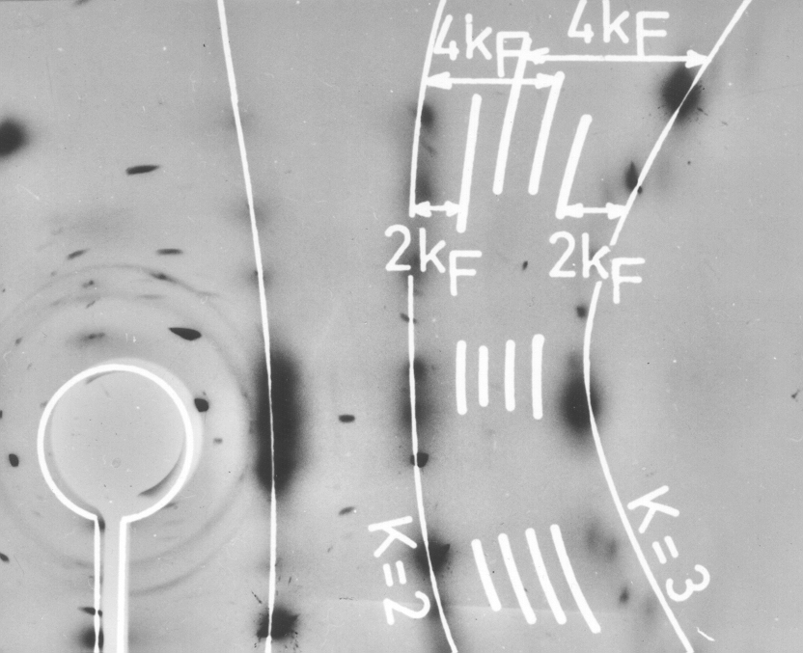
TTF-TCNQ: 2kF and 4kF CDW/BOW!
b*
Charge transfer
ρ=0.59
2kF
4kF
2kF instability on the TCNQ stack
T=60K
4kF instability on the TTF stack
J.-P. Pouget et al PRL 37, 873 (1975); S.K. Khanna et al PRB 16, 1468 (1977)
S. Kagoshima et al JPSJ, 41, 2061 (1976)

Slide 11
Collective description for generic 1D Mott state = 4K_{F} CDW.
Spin degrees of freedom are gapless, split-off and not important for a while.
Charge degrees of freedom: phase ϕ=ϕ(x,t)
2K_{F} CDW/SDW ~cos (ϕ+xπ/2a) 4KF CDW~ cos (2ϕ+xπ/a)
Two fold commensurability: pinning potential potential and its degeneracy.
Wave function Ψ distriburtion at E_{F} (for the site dimerisation):
+ o - o + o - o

ϕ=0,π: Ψ=±1 at good sites  and Ψ=0 at bad sites 
ϕ=π/2: Ψ=0 at good sites  and Ψ= =±1 at bad sites 
H~ (/4πγ) [v_{ρ} (∂_{x}ϕ )² + (∂_{t}ϕ )2 /v_{ρ} ] - Ucos (2ϕ) + Wcos (4ϕ)
U is the commensurability energy or the Umklapp scattering amplitude.
Its presence is the main feature of systems with a single electronic mean occupation. The generosity of (TMTCF)₂X - small U, hence the “charge localization” crossover.
without interactions γ=1 and v_{ρ}=v_{F}

Slide 12
The ground state is doubly degenerate between ϕ= 0 and ϕ= ±π. H_{U}= -Ucos (2ϕ)
It allows for phase π solitons, i.e. holons with the charge e.
Purely on-chain solitons, exist as conducting quasiparticles both above and below the T_{FE}.
φ=0
φ =π

Slide 13
COMBINED MOTT - HUBBARD STATE
H~ [v_{ρ} (∂_{x}ϕ )² + (∂_{t}ϕ )² /v_{ρ} ] + H_{U}
Chiral phase ϕ=ϕ(x,t) for electrons near +/-K_{F}
U: amplitude of the Umklapp scattering
Dzyaloshinskii & Larkin, Luther & Emery
Other views: commensurate Wigner crystal, 4K_{F} CDW (Pouget et al)
2 types of dimerization ⇒
2 interfering sources for two-fold commensurability
⇒ 2 contributions to the Umklapp interaction:
Site dimerization : H_{U}^{s}=-U_{s} cos 2ϕ (spontaneous)
Bond dimerization : H_{U}^{b}=-U_{b} sin 2ϕ (build-in)
At presence of both site and bond types
H_{U}= -U_{s}cos 2ϕ -U_{b}sin 2ϕ = -Ucos (2ϕ-2α)
U_{s}≠0 → α ≠0 → phase ϕ = “mean displacement of all electrons”
shifts from ϕ =0 to ϕ = α, hence the gigantic FE polarization.
From a single stack to a crystal: Macroscopic FerroElectric ground state if the same α is chosen for all stacks,
Anti-FE state if the sign of α alternates - both cases are observed

Slide 14
Spontaneous U_{s} itself can change sign between different FE domains.
Then electronic system must also adjust its ground state from α to -α.
Hence the domain boundary U_{s}↔-U_{s} requires for the
phase soliton of the increment δ =-2α
which will concentrate the non integer charge q=-2α/π per chain.
φ =- α
alpha- solitons are walls between
domains of opposite FE polarizations
φ= α
They are on-chain conducting particles only above T_{FE}.
Below T_{FE} they aggregate into macroscopic walls.
They do not conduct any more,
but determine the FE depolarization dynamics.

Slide 15
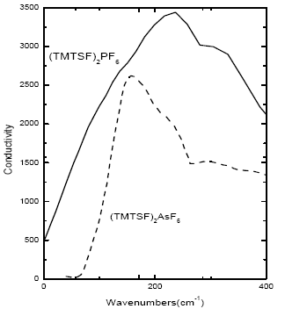
First evidence for solitons = holons:
the activated conductivity with gapless spin susceptibility
Second evidence – optical gaps, even in case of remnant metals.
E_{g}=2Δ - unbound
pair of kinks
Exciton = two-kinks bound state
Peierls
spin gap
Drude
peaks
Optical conductivity (absorption): M. Dressel, L. Degiorgi et al

Slide 16
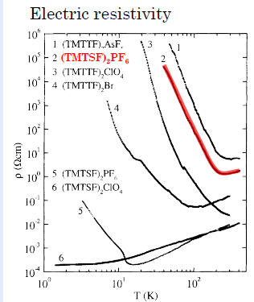
Post-Charge Ordering -
low T phase transitions:
spin-Peierls, AFM, SDW,
anion ordering

Slide 17
Effects of subsequent symmetry lifting.
Topologically confined solitons. Spin-Charge reconfinement.
Another present from the Nature:
second symmetry lowing transition of tetramerization
SCN
Ahrenius plots for the cobductivity.
Inclination gives the activation energy
for charge carriers
ReO4
Spin-charge reconfinement below T_{AO} of tetramerisation. Enhanced gap Δ comes from topologically coupled π- solitons in both sectors of the charge and the spin. The last is weakly localized. What does it mean ?
Spin degrees of freedom enter the game:
θ - spin chiral phase, θ′/ π = smooth spin density

Slide 18
Schematic illustrations for effects of the tetramerization
nonequivalence of bonds = , -- between good sites 
endorses ordering of spin singlets.
Also it prohibits translations by one    distance
which were explored by the δϕ=π soliton.
But its combination with the defected unpaired spin
(δθ=π soliton which shifts the sequence of singlets)
is still allowed as the selfmapping –
connction of equivalent ground states

Slide 19
Further symmetry lifting of lattice tetramerization or of spin-Peierls order
mixes charge and spin: additional energy
Vcos (ϕ-β)cos θ - on top of ~Ucos (2ϕ-2α)
ϕ and θ -- chiral phases counting the charge and the spin
ϕ ′/ π and θ′/ π = smooth charge and spin densities
cos θ sign instructs the CDW to make spin singlets over sorter bonds
Major effects of the small V - term :
Opens spin gap 2Δ_{σ} :
triplet pair of δθ=π solitons at ϕ=cnst
Prohibits δϕ =π solitons –
now bound in pairs by spin strings
Allows for combined spin-charge
topologically bound solitons:
{δϕ =π , δθ=π} – leaves the V term invariant
Quantum numbers of the compound particle --
charge e , spin ½ but differently localized:
charge e , δϕ =π sharply within ħv_{F}/Δ_{ρ}
spin ½ , δθ =π loosely within ħv_{F}/Δ_{σ}
s
p
I
n
c
h
a
r
g
e
s
p
I
n

Slide 20
CASES OF CONTINUOUS DEGENERACY
Limitation of cases of discrete symmetry breaking:
Solitons can be created only in pairs, even in 1D.
In D>1 they are either permanently confined in pairs
or aggregated into macroscopic domain walls.
A higher continuous degeneracy -
superconductors, SDWs, incommensurate CDWs -
allows for existence and creation of isolated solitons,
of direct conversion of a single electron into a single soliton.
In 1D, a single electron becomes unstable with respect to its selftrapping - transformation into a soliton.
In D>1, the soliton gives a nucleus of a complex topological with reconfinement of the spin and the charge.

Slide 21
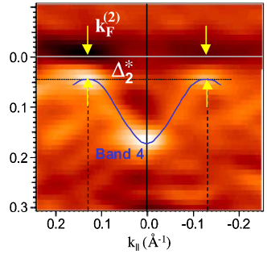
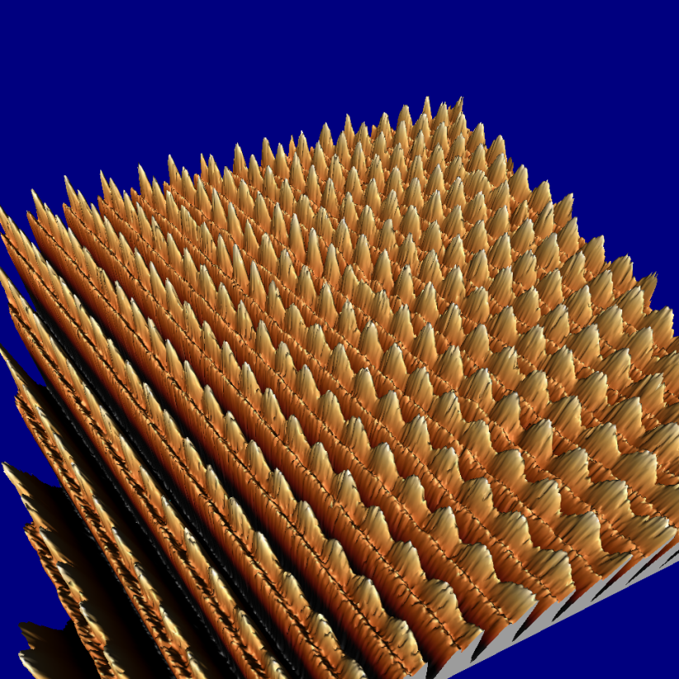
Incommensurate, 3D ordered Charge Density Waves - CDW
ARPES gives electrons’ spectral density, hence E(k) with the gap Δ
formed by the CDW
CDW
wave
fronts
Scanning Tunneling
Microscopy STM shows
the CDW modulation in
atomic displacements
and the electronic density.
Brun, Wang, Monceau, SB
chains

Slide 22
Electrons with a weak repulsion can form the spin density wave - SDW self-consistently, modulating their charge or spin density.
CDW: Q=2k_{F} mixes –k_{F}↑ and k_{F}↑ ; –k_{F}↓ and k_{F}↓
SDW: Q=2k_{F} mixes –k_{F}↑ and k_{F}↓ ; –k_{F}↓ and k_{F}↑
SDW is the case of many organic metals and the special case of cromium
Both CDW and SDW are electronic crystals with 2 electrons per unit cell.
At first sight, they are insulators by general principles of band theory, even if the bands are formed by a spontaneous symmetry breaking.
But this degeneracy brings to life new ingredients:
collective modes and solitons.

Slide 23
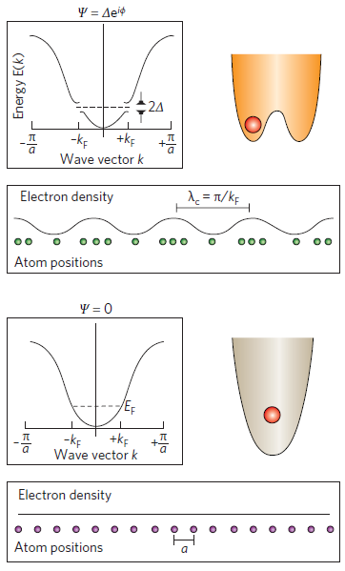
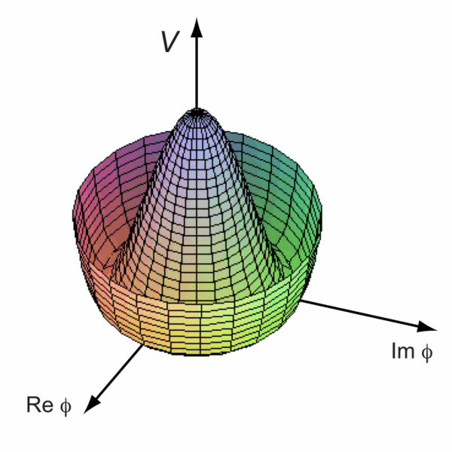
Two-component or “complex” order parameter =
vector (u,v) of the complex field Ψ=u+iv=Aexp(iφ):
Easy-plane ferromagnets,
Bose-condensates,
superconductors, Incommensurate
charge density waves ICDW.
ICDW order parameter:
O_{CDW} ~Acos(Qx+ϕ)
A – amplitude ϕ - the phase
ISDW order parameter:
O_{SDW} ~m cos(Qx+ϕ)
m – staggered magnetization vector

Slide 24
Landau theory of phase transitions with symmetry breakings
2- component =“complex” order parameter :
Ferroelectrics, uniaxial easi-axis ferromagnets, lattice dimerizations.
Static states – minima of
Phase-locking c-term appears only for 3-fold commensurate 1D CDW or for the triangular arrangement of the triple CDW in 2D

Slide 25
Add a single electron or hole near the gap rims, ±Δ₀, allow for deformations of the gap: amplitude Δ=Δ₀+δ and phase  d /dx=  ′.
Check for stability:
Topological soliton !
Charge of trapped electron
is exactly compensated

Slide 26
Precisions from exact solutions
family of chordus solitons
Δ
2
V₁
2π
SOLITON
θ
E
V₂
2θ
E
-
Sequence of chordus solitons develops from bare θ=0 through
the amplitude soliton at 2θ=π to the full phase slip 2θ=2π.
Intra-gap split-off state E evolves from Δ₀ to -Δ₀ providing spectral flow across the gap together with the electrons’ conversion.
V_{n}(θ) - selftrapping branches of the total energy for chordus solitons with
the intragap state fillings n =1 and n=2.

Slide 27

Complex order parameter , Incommensurate CDWs.
Noninteger variable charges.
Modeling for the amplitude π-soliton = spinon in the CDW
Localisation of the
self-trapped electron
(A,ϕ) trajectory of the CDW order parameter Acos(Qx+ϕ)
This is the state of a 1D CDW or 1D superconductor
with one added unpaired electron.
Solitons are stable energetically but not topologically.
Special significance:
allowance for a direct transformation of
one electron into one soliton.
(Only 2→2 allowed for dimerization kinks)

Slide 28
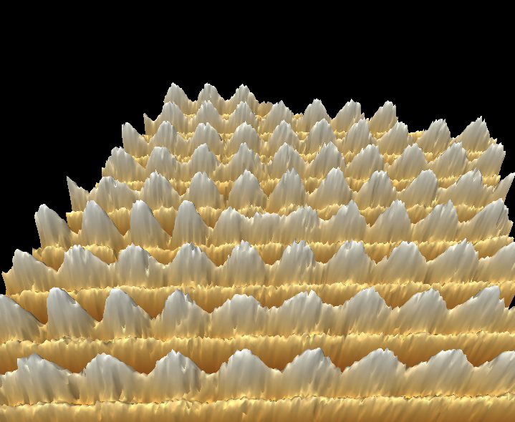
STM view of the CDW1 in NbSe3
STM is tuned to see only the CDW
The chain
bearing
the soliton
S. B., C. Brun, Z.-Z. Wang, and P. Monceau, Phys Rev Let (2012)

Slide 29
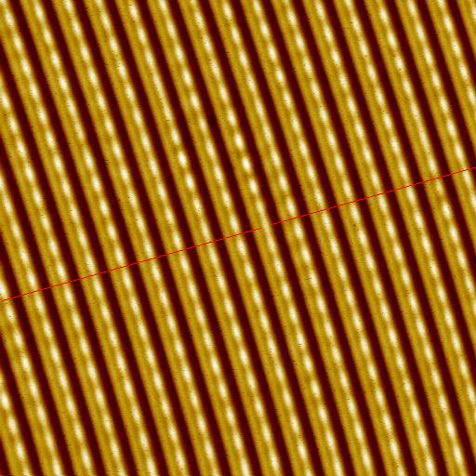
Solid lines: maxima of the charge density. Dashed lines:
chains of the host crystal.
By passing each of these defects, the phase changes by 2π. Far from the defect,
the lattice is not perturbed.
At the (red) front line the defected chain is displaced by half of period.
Along the defected chain the whole period ±2π is missed or gained
Embracing only one chain of atoms, the pairs become a vacancy or an interstitial
⇒ ± 2π solitons in CDW
Expected, phase only, defect of a minimal size dislocation loop?
Protected by charge conservation, created by extraction of a pair of electrons from the CDW at one chain.

Slide 30

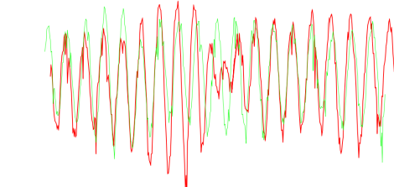
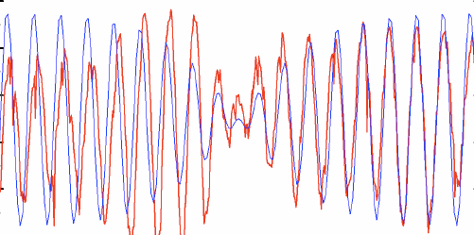
The CDW is perforated here and there by nodes of amplitude
Profile along the defected chain
vs its nearest neighbor
Defected chain vs theory
Phase stretching by π over long tails allows the amplitude kink to adapt to a long range 3D order. General concept: topologically
bound complex of the kink core and the half-integer vortex.

Slide 31
Soliton is a light particle, M_{s}~m_{b}.
To be seen by STM, it needs to be
immobilized - trapped by a host lattice defect.
Could it be that we saw an impurity effect rather than the soliton?
No, the impurity gives an opposite effect – the Friedel oscillation
which was identifed also in the same set of experiments.
FO~Cos(2K_{F}x)|x|⁻¹ Exp(-|x|/ξ) cf. Ishioka et al, 2011
Low T
High T
High T

Slide 32
Can the solitons cross the boarder to the higher D world ?
Are they allowed to bring their anomalies like
spin-charge separation or mid-gap states?
Password : confinement.
As topological objects connecting degenerate vacuums,
solitons acquire an infinite energy unless they
reduce or compensate their topological charges.
Various scenarios :
Compensation by the gapless mode S.B. 1980, 2000's
Aggregation into domain walls versus their melting by thermal deconfinement or long rage Coulomb forces
S.B. & T.Bohr 1983, S. Teber 2001
Coupling to structural defects in polymers.
Binding to kink-antikink pairs, origin of bipolarons.
S.B. & N.Kirova, 1981- 90’s
Topological binding to gapless degrees of freedom

Slide 33
FROM SOLITONS TO STRIPES at HIGHER DIMENSIONS
FINITE TEMPERATURE, ENSEMBLES OF SOLITONS,
PHASE TRANSITIONS OF SOLITONS’ CONFINEMENT
AND OF THEIR AGGREGATION INTO STRIPES.
Solution for a statistical model T.Bohr and S.B. 1983,
S.Teber and SB 2000’s, P.Karpov and SB 2016

Slide 34
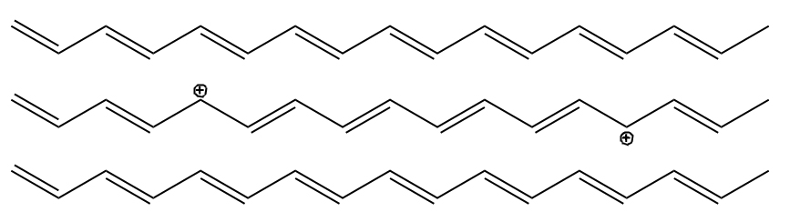
(CH)x – 3D phase
In-phase
Out of phase
In-phase
Interaction of chains brings confinement of solitons into pairs.
In-between the kinks, the interchain correlation is broken,
hence the confinement energy W_{cnf} = F|x|;
Two competing effects:
Binding of kinks into pairs;
Aggregation into macroscopic domain walls.
Solution for a statistical model T.Bohr and S.B. 1983,
S.Teber and SB 2000’s, P.Karpov and SB 2016
Notes:
Mismatch between the phase

Slide 35

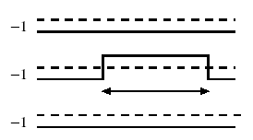
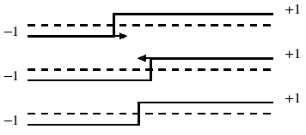
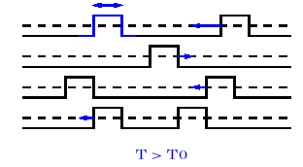
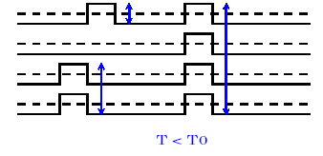
FINITE TEMPERATURE, ENSEMBLES OF SOLITONS,
PHASE TRANSITIONS OF CONFINEMENT AND AGGREGATION.
DISCRETE SYMMETRY only.
Fatal effect upon kinks: global lifting of degeneracy, hence confinement.
Nontrivial but still spectacular:
local lifting in the state with long range order.
Interchain coupling of the order parameter.
Two competing effects:
Binding of kinks into pairs at T<T_{c};
Aggregation into macroscopic domain walls at T<T₀<T_{c}.
Solution for a statistical model T.Bohr and S.B. 1983, S.Teber et al 2000’s

Slide 36
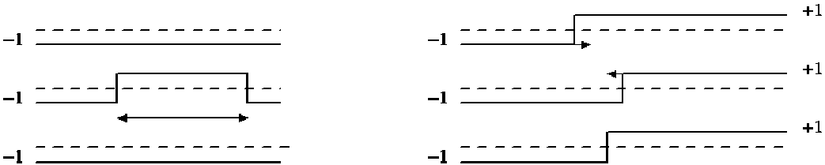

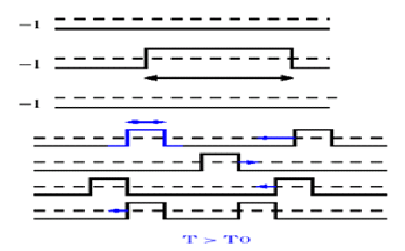

High temperature T > T1: Solitons exist as individual entities.
They already experience long range attractions towards binding them into pair at the same chain (left panel)
or to walls at neighboring chains (right panel).
Intermediate temperatures T1 >T > T2. No more individual solitons, but a gas of their conned pairs. Pairs’ lengths are loose and fluctuate at T1 > T > J; they are tight at J > T > T2.

Slide 37
Lower temperature below T2:
Another transition (D=3) or a crossover (D=2) for formation of
macroscopic domain walls made from
transversely aggregated kinks.
At T<T2 they are embedded to the gas of bikinks;
At T→0 they absorb all particles.

Slide 38
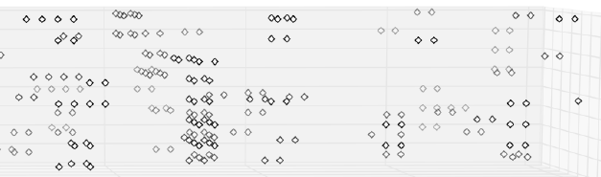
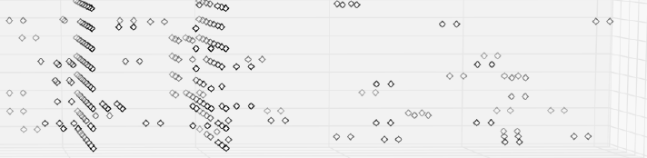
T<T2 : macroscopic domain walls are formed from transversely
aggregated kinks by a second phase transition at T2.
T=2.1J⊥
T=2.0J⊥

Slide 39
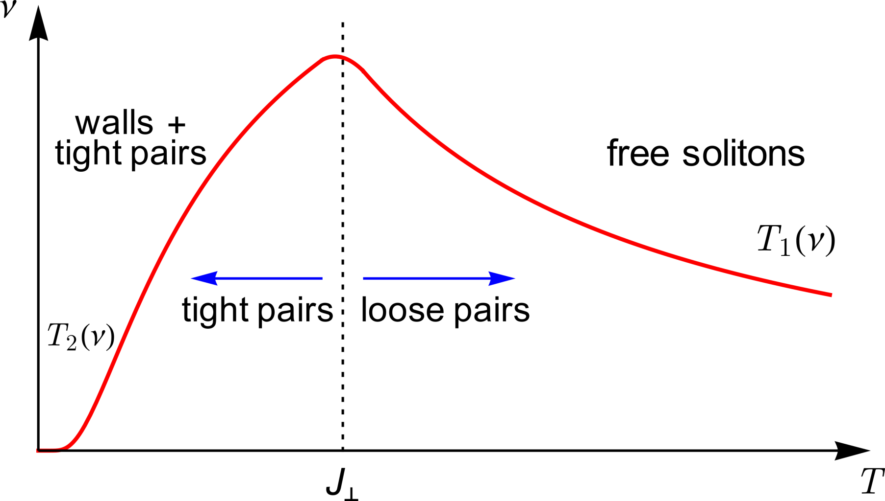
Phase diagram of a neutral 3D system in temperature-concentration coordinates.
The region under the curve is the phase of bisolitons (the Ising-ordered phase).

Slide 40
Major puzzle and inspiration in CDWs: amplitude solitons
within the long range ordered phase at T<T_{c}
Obstacle : confinement.
Changing the minima on one chain would lead to
a loss of interchain ordering energy ~ total length.
Need to activate other modes to cure the defect !
Unifying observation :
combination of a discrete and continuous symmetries
Complex Order Parameter O= A exp[iϕ] ; A - amplitude , ϕ - phase
Ground State with an odd number of particles:
In 1D - Amplitude Soliton O(x=-∞) ⇔ - O(x=∞)
performed via A ⇔-A at arbitrary ϕ=cnst
Favorable in energy in comparison with an electron, but: Prohibited to be created dynamically even in 1D
Prohibited to exist even stationary at D>1
RESOLUTION – Combined Symmetry :
A ⇔-A combined with ϕ→φ+π – semi-vortex of phase rotation compensates for the amplitude sign change

Slide 41
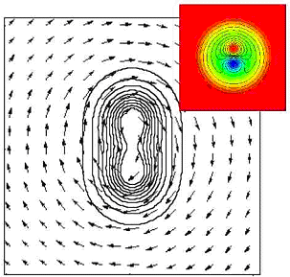
π -vortices
core :
kink
kink + ½ roton combination,
the superconductor or the CDW.
At presence of unpaired spins,
The 1 vortex splits into two 1/2.
D. F. Agterberg, et al 2008; K. Kasamatsu, et al 2004

Slide 42
At presence of unpaired spins,
the vortex splits into two semi-vortices.
Spatial Line Nodes and Fractional Vortex Pairs in the FFLO Vortex State of Superconductors
D. F. Agterberg, Z. Zheng, and S. Mukherjee 2008
Vortex molecules in coherently coupled two-component Bose-Einstein condensates
K. Kasamatsu, M.Tsubota, and M. Ueda 2004
Last step: reformulate these results inversely –
unpaired spin creates the vortex pair
at NO rotation/MF.

Slide 43
+
Kink-roton complexes as
nucleuses of melted lattices:
FFLO phase for superconductors
or strips for doped AFMs.
+
-
+/-
-/+
-
+
+
Defect is embedded into the regular stripe structure (black lines).
+/- are the alternating signs of the order parameter amplitude.
Termination points of a finite segment L (red color) of the zero line must be encircled by semi-vortices of the π rotation (blue circles)
to resolve the signs conflict.
The minimal segment would correspond to the spin carrying kink.
Vortices cost ~E_{phase}logL is less than the gain ~-ΔL
for the string formation at long L. Can we shrink to the atomic scale?
For smallest L~"unit cell", it is still valid in quasi 1D : E_{phase}~T_{c}<Δ
For isotropic SCs, E_{phase}~E_{f} – strong coupling is necessary.

Slide 44
SPIN-GAP cases - superconductivity or incommensurate CDW.
Bosonisation language :
Η_{1D}~(∂θ)² -Vcos(2θ)} +(∂ϕ)²
V - from the backward exchange scattering of electrons
In 1D : Spinon as a soliton θ→ θ+π hence s=1/2
+ Gapless charge sound in ϕ.
CDW order parameter ~ ψ†_{+↑} ψ_{-↑} + ψ †_{+↓} ψ_{-↓} ~ exp [iϕ] cosθ
Its amplitude cosθ changes the sign along the allowed π soliton
Same for the superconductivity with another (gauge) phase ϕ
At higher D : allowed mixed configuration
θ → θ+π , s=1/2 ϕ → ϕ+π , e=1
↑spin soliton ↑ ↑charged wings↑
Spinon as a soliton +
semi-integer π-vortex of ϕ
confined
spin

Slide 45
At presence of unpaired spins, the vortex created by rotation (magnetic field) splits into two semi-vortices.
Spatial Line Nodes and Fractional Vortex Pairs in the FFLO Vortex State of Superconductors
D. F. Agterberg, Z. Zheng, and S. Mukherjee 2008
Vortex molecules in coherently coupled two-component Bose-Einstein condensates
K. Kasamatsu, M.Tsubota, and M. Ueda 2004
Last step: reformulate these results inversely –
unpaired spin creates the vortex pair
at NO rotation/MF.

Slide 46
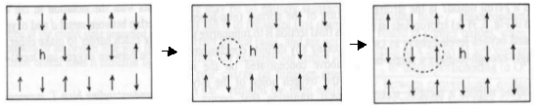
Propagating hole as an amplitude soliton.
Its motion permutes AFM sublattices ↑,↓
creating a string of the reversed order parameter:
staggered magnetization. It blocks the direct propagation.
Bulaevskii, Khomskii, Nagaev.
Brinkman and Rice.
Adding the semi-vorticity to the string end heals the permutation
thus allowing for propagation of the combined particle.
spin flipping
spin rotations
by hole motion
Alternative view:
Nucleus of the stripe phase or the minimal element of its melt.

Slide 47
Half filled band with repulsion.
SDW rout to the doped Mott-Hubbard insulator.
Η_{1D}~(∂ϕ)² -Ucos(2ϕ)+(∂θ)²
U - Umklapp amplitude
(Dzyaloshinskii & Larkin ; Luther & Emery).
ϕ - chiral phase of charge displacements
θ - chiral phase of spin rotations.
Degeneracy of the ground state:
ϕ →ϕ+π = translation by one site
Staggered magnetization ≡ AFM=SDW order parameter:
O_{SDW} ~ cos(ϕ) exp{±i(Qx+θ)} , amplitude A= cos(ϕ) changes the sign
To survive in D>1 : The π soliton in ϕ : cos ϕ → - cos ϕ
enforces a π rotation in θ to preserve O_{SDW}
spin flipping
spin rotations
by hole motion

Slide 48
OUTLOOK
Existence of electronic solitons is proved experimentally for CDWs in several classes of quasi-1D conductors.
Solitons feature self-traping of electrons into mid-gap states and separation of spin and charge into either spinons or holons, sometimes with their reconfinement.
Continuously broken symmetries allow for solitons to enter
D>1 world of long range ordered states: SC, ICDW, SDW.
Solitons take forms of amplitude kinks, topologically bound to
semi-vortices of gapless modes – half integer rotons.
These combined particles substitute for electrons: certainly in quasi-1D systems – for both charge- and spin- gaped cases.
The description is extrapolatable to strongly correlated isotropic cases: from dopped AFM insulators to FFLO in superconductors.
Here it meets the picture of fragmented stripe phases.

