Slide 1
Electronic States and Phases Induced by
Electric or Optical Impacts.
IMPACT-2012, Orsay, France IMPACT-2016, Carges, France
2000’s accelerating mainstream in the condensed matter physics:
IMPACT transformations of electronic states/phases under strong external influences. The confluence of two streams:
Electrostatic doping = Field-Effect with extremely high electric fields
to reach a critical surface concentration of carriers.
Main target: switching on or off the superconductivity or the Mott state.
Successes: Geneva U., Brookhaven NL, Tokyo U., Cambridge
- This lecture
B. Persistent or short-lived transformations induced by a laser pumping.
Ingredients: pump and probe optics with the femto-second resolution,
Tera-Hz pulses, evolution of the transformed states, hidden states.
Time-resolved ARPES or X-ray diffraction.

Slide 2
Unrivaled glory of Bell Labs, from the mighty ATT
Transistors, field-effect transistor (MOSFET);
Zone melting for semiconductors; Molecular beam epitaxy;
CCD: charge-coupled device (digital cameras, Hubble);
Lasers (gas, semiconducting, organic), quantum cascade IR laser;
Laser cooling of atoms;
Fractional quantum Hall effect;
Radio astronomy, background radiation from the Big Bang;
Information theory, codes for error detection and correction.
Unix operating system, C, C++ programming languages;
Shor quantum factorization algorithm,
Digital cellular telephone technology, Fiber optic
Theoretical physics (PW Anderson at the top)
8 Nobel Prizes

Slide 3
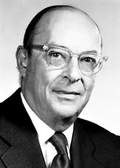
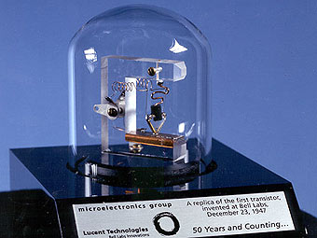
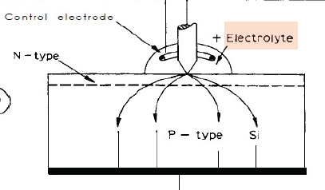
John Bardeen
Nobel Prizes in Physics 1956 and 1972
The personal synergy of inventions
in semi- and superconductivity;
now it is materialized through experimental achievements of 2000’.
Bardeen, Shockley and Brattain

Slide 4
Bell Labs within Lucent Technologies: struggling the decline.
Jan Hendrik Schön affair 2000-2003
Claims for possessing an “alchemical gold”:
the “philosopher stone” transforming any material to any electronic state by means of the Field-Effect = Electrostatic Doping
Publications in Science alone:
"Ambipolar Pentacene Field-Effect Transistors and Inverters”
"A Superconducting Field-Effect Switch".
"Fractional Quantum Hall Effect in Organic Semiconductors”
"An Organic Solid State Injection Laser".
"A Light-Emitting Field-Effect Transistor".
"Josephson Junctions with Tunable Weak Links”
"High-Temperature Superconductivity in Lattice-Expanded C60".
"Field-Effect Modulation of the Conductance of Single Molecules".
Science withdrew these eight papers written by Schön
with senior coauthors + as many from other top journals

Slide 5
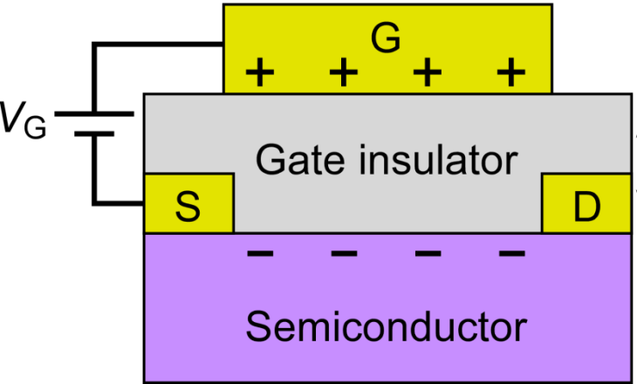
The earlier injection transistor was used for signal amplification
(the Sony walkman proclaimed the mineaturization epoch)
The modern choice for switching is the FET – field effect transistor
Gate voltage controls the concentration of carriers
between the source S and the drain D electrodes
The operation scale: 10⁻⁶ e/site.
Dream: get 10⁻¹ e/site to reach transitions to new electronic states
Price: need almost intra-atomic scales of the electric field.

Slide 6
Field effect dream to transform any material to any electronic state.
Anticipating a tunable superconductivity
Bell Labs, H.Shoen affair – its very negative and well stimulating impact
2002 Darkness in the Murray Hills tunnel
2002 + Side light at the Alpine tunnel section - Geneva.
2003 + Light at the Pacific end of the tunnel - Japan.
2010 Explosions of studies on oxides and organic conductors.
1980/90’s Theorists calling – Russia, Swiss.
Goal: create a field effect injection up to ~10% per surface unit cell.
Ingredients of modern research:
Active material, accepting either electrons or holes, and possessing different ,
tunable – insulating , metallic, superconducting – ground states :
High-Tc superconductors - cuprates and pnictides - in antiferromagnetic states,
transition metals oxides with charge- and orbital- ordering and magnetism,
transition metals halcogenides with charge density waves,
organic conductors with the charge ordering,
conducting polymers.

Slide 7
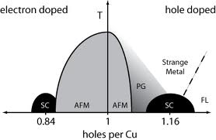
Field effect transistor, FET.
Metal–oxide–semiconductor
FET (MOSFET)
Gate
Source
Gate dielectric
Drain
Active material
Field effect transistor, FET x~10⁻⁶ el/atom
High-temperature superconductors
- - - - - - -
Need x~0.1 el/atom !
Requires for the electric field
εE>10MV/cm

Slide 8
Untimely theories
1. Early 80’s, rise of conducting polymers.
Metallization of polyacetylene by doping 1979.
Dissatisfaction about effects of charged disorder.
Additional intrigue:
Firm theoretical and experimental grounds for formation of bipolarons – 2-electron particles, prone to superconductivity.
Desire: to obtain them in a pristine state. Hence two suggestions:
S. B. and N. Kirova 1981 Call for optical pumping of solitons
S.B. N.K. and V. Yakovenko , Solid State Commun. 1985
"On the possible superfluidity of bipolarons at the junction surface

Slide 9
2. Late 80’s, Epoch of high-Tc superconductivity.
Dissatisfaction about effects of charged, substitutional and oxygen disorders.
Intrigue: Intrinsic relation of the superconductivity in the doped state and
the pristine antiferromagnetic Mott insulator
Desire: to obtain the superconductivity without doping. Hence the suggestion:
Possible superconductivity on the junction surface of dielectric La₂CuO₄
S. B. and V. Yakovenko, JETP Let. & Phys. Let. 1988
“... induce excess charge on the surface of the dielectric La₂CuO₄
by the field effect transistor or in the Schottky junction.
... Superconductivity can be observed in this two dimentional system
… to manufacture superconducting devices controlled by electric field …”
J. Mannhart and A. Baratoff, "Superconducting p-n junctions" 1993 Possibility to explore existence of both n- and p- doped cuprates.

Slide 10
Feasibility of the extreme Field Effect as seen 2 decades ago
V. Yakovenko 1988, unpublished.
Achievable concentrations of electrons at the surface of the CuO₂ plane
for different gate dielectrics. x=15% was most wanted.
Dielectrics | E_{D} 10⁶V/cm | ε_{D} | ε_{D} E_{D} 10⁷V/cm | n=ε_{D}E_{D}/4πe 10¹³ cm⁻² | x=n(3.8A)² in % - 10⁻²
SiO₂ | 6 | 4- 10 | 2.4 - 6 | 1.3 – 3.3 | 1.9 – 4.8
Al₂O₃ | 5 | 8 - 9 | 4 – 4.5 | 2.2 - 2.5 | 3.2 – 3.6
Y₂O₃ | 5 | 9 - 13 | 4.5 – 6.5 | 2.5 – 3.6 | 3.6 – 5.2
HfO₂ | 50 | 15 | 75 | 41.4 | 60
PbTiO₃ | 0.5 | 30 - 200 | 1.5 – 10 | 0.83 – 5.5 | 1.2 – 7.9
Notice the promising case of HfO₂ gate. Exotic in mid-80's,
it became a working material today, in epoch of high-K and 20’s nm.

Slide 11
Experimental Strategy | Achievements
Pure FET | Insulator - Metal transition in SrTiO3 | 2003 AIST, Tsukuba
Pure optical pumping, no gate. | R_{1-x}A_{x}MnO₃ Transformation : charge-orbital ordered insulator --> ferromagnetic metal | Miyano 2005 (Tokyo U.)
MBE+ ferroelectric MBE – Molecular Beam Epitaxy | Electrostatic Modulation of Superconductivity in GdBa₂Cu₃O_{7–x} Variable atomic layeres SC at interface of LaAlO/SrTiO3 | Triscone 1999 Geneva) Bozovic (BNL, USA) Reyren 2007, Triscone 2008
Gate voltage + optical pumping across the gate | Photoinduced IMT VO2, TiO2, LaSrMnO3 CaCuO2 | Hiroi 2002 (ISSP, Japan)
Double-Layer Transistor by electrolyte gating | Surface carrier density reached 10¹⁵ /cm² Superconductor–insulator transition in La_{2-x}Sr_{x}CuO₄ | Iwasa 2008 (Tokyo ) Bozovic 2011 (BNL, USA)

Slide 12
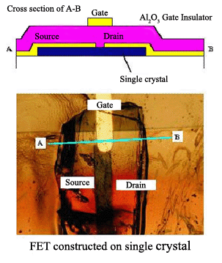
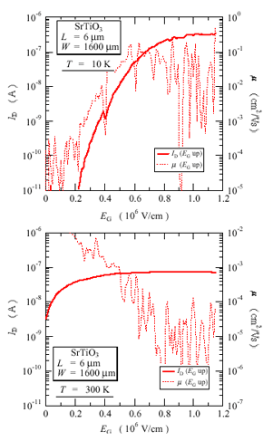
Field effect doping of SrTiO₃
Inoue et al, CERC AIST, Tsukuba, Japan
Direct assault at a minimal possible frontier.
Micro gate area may have no leakage defects.
Drain current I_{D} (solid line) and the charge mobility (dashed line) plotted against the gate electric field E_{G}
10K

Slide 13
Strategy 2. Direct assault, pure optical pumping, no gate.
Photoinduced insulator-to-metal transition
K. Miyano & N. Takubo, University of Tokyo. 2005
Perovskite manganites, R_{1-x}A_{x}MnO₃
(compounds of the colossal magnetoresistance)
Transformation : charge- and orbital-ordered insulating (COOI) state
➔ ferromagnetic metallic (FMM) phase
Pr_{0.55}(Ca_{1-y}S_{y})_{0.45}MnO₃ film on
(LaAlO₃)_{0.3}(SrAl_{0.5}TaO₃)_{0.7} (110) substrate, y = 0.25
Photon energy is 2.3 eV
Laser pulses transform COOI ➔FMM

Slide 14
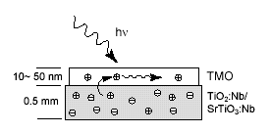
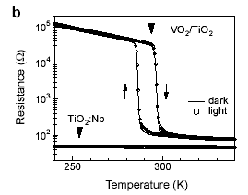
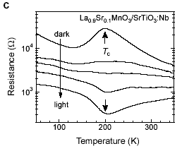
Photocarrier Injection to Transition Metal Oxides
Y. Muraoka and Z. Hiroi -- ISSP, Japan
Strategy 3. Combination of the gate voltage
with the optical pumping across the gate
Estimated photo-doping:
~10²⁰/cm³ , i.e. 1% per atom

Slide 15
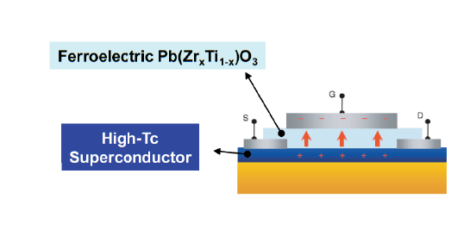
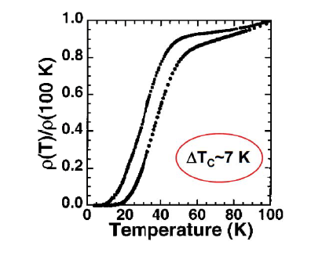
4. Gigantic amplification of the gate voltage in the field effect by adding the ferroelectric layer.
Electrostatic Tuning of the Hole Density in NdBa2Cu3O_{7-x}
Films and its Effect on the Hall Response
J.-M. Triscone group, Geneve. Phys. Rev. Let. 2002 (first results 1999)
Ferroelectric gate – switching requires only a voltage pulse,
Persistent reversible effect.
Achieved: switching off of the superconductivity in a pre-doped material.
Still necessary: turn the SC on from the pristine undoped insulator

Slide 16
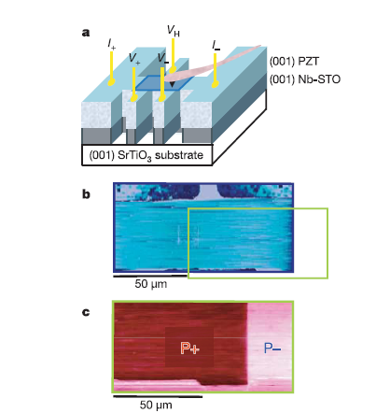
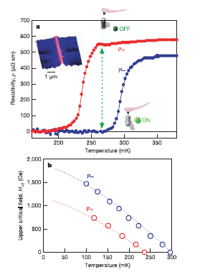
Local switching of two-dimensional superconductivity using the ferroelectric field effect J.-M. Triscone, et al Nature 441 (2006) 195
The P+ state - removing electrons from the Nb-STO layer.
The P- state - adding electrons to the Nb-STO layer (increasing the doping)

Slide 17
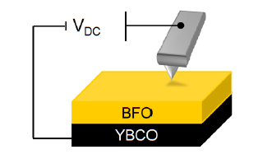

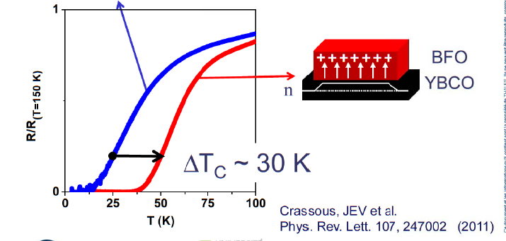
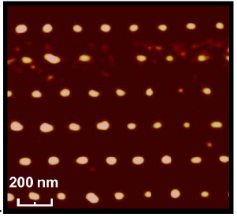
Today: nanoscale manipulations (Villegas et al, Thales, France)
Magnetic flux vortices
BiFeO₃ (BFO) P∼100μ C/cm²
YBa₂Cu₃O_{7-δ} (YBCO) Tc=92 K

Slide 18
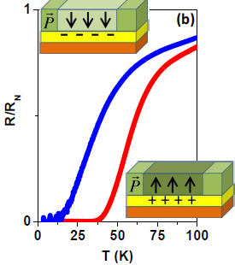
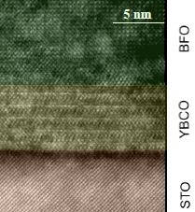
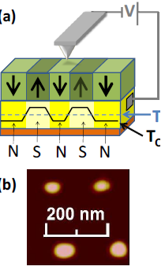
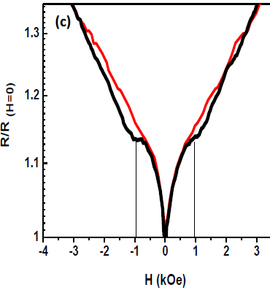

Slide 19
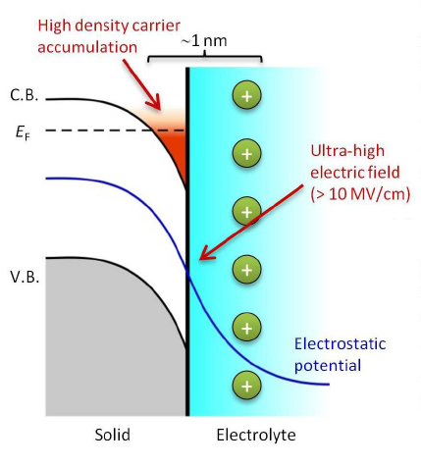
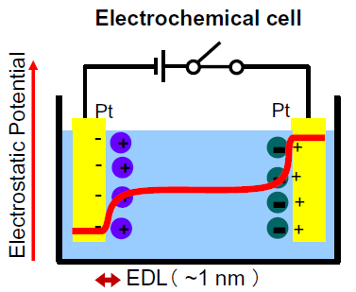
Iterdisciplinary: gate dielectric - electrolytic condensor
– from polymeric FET (Invented for doping by/of conducting polymers)

Slide 20
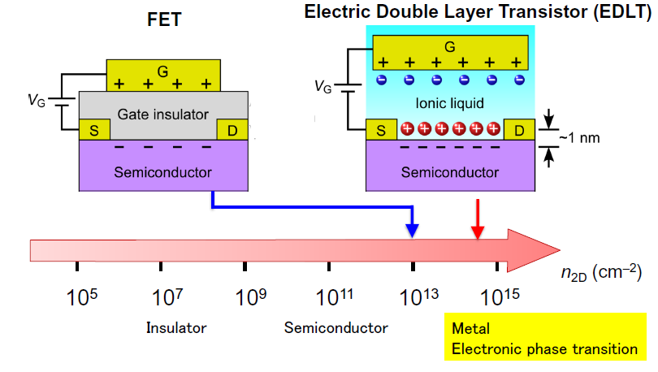
Fig. taken from Y. Iwasa @ IMPACT-2016

Slide 21

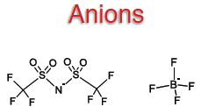
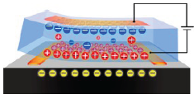
Ionic Liquid
polymer electrolyte, polyethylene oxide containing KClO4

Slide 22
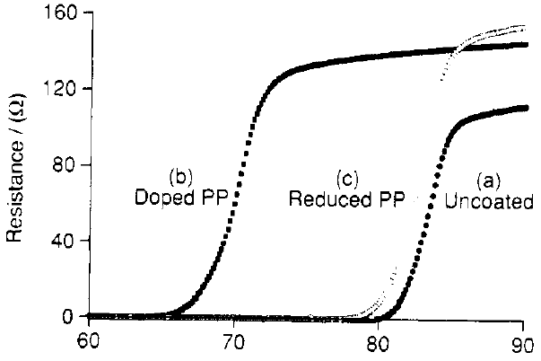
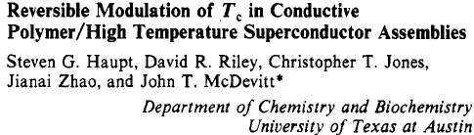
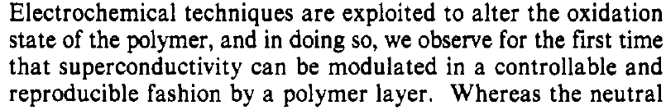


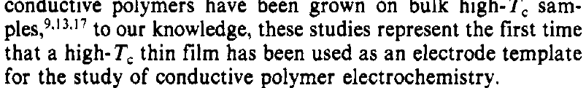
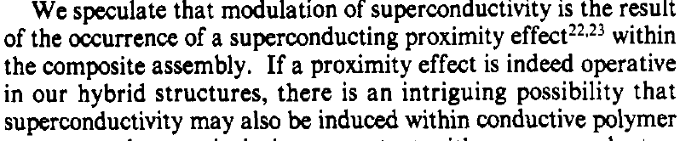

Slide 23
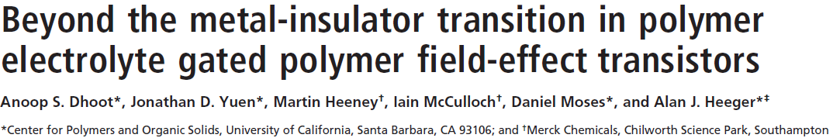
Polymer Electrolyte-Gated Organic Field-Effect Transistors
M. J. Panzer and C. D. Frisbie Univ. of Minnesota mid-2000’s
Still, the J. of American Chemical Society
Physics journals at last: PNAS2006, + |NMAT 2009

Slide 24
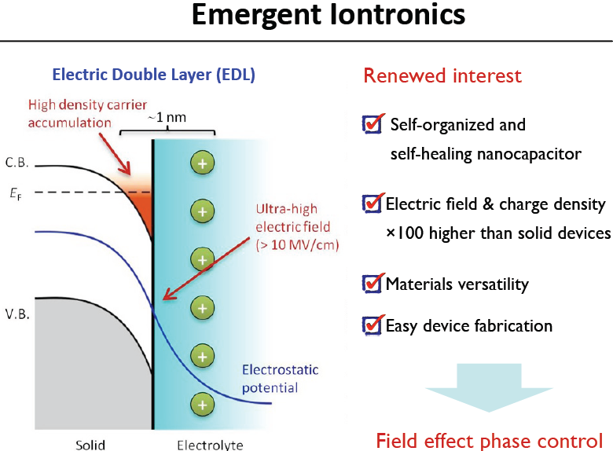
J. T. Ye, Y. Tokura, and Y. Iwasa; U. of Tokyo

Slide 25
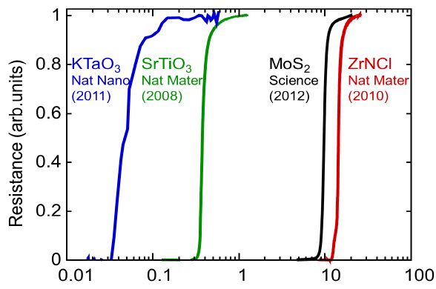
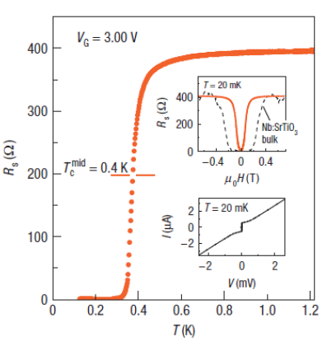
Electric-field-induced superconductivity in an insulator
Iwasa group (Sendai) Nature Materials 7 (2008) 855; 9, 125 (2010).
R.H. Friend group (Cambridge UK): Adv. Mater. 22, 2529 (2010).
pristine SrTiO₃ as chanel, liquid – solid electrolyte – as gate dielectric
Cations (K+) in the electrolyte are solvated by polyethylene oxide molecules and are electrostatically adsorbed on the SrTiO₃
V_{G} = 3.5 V, n_{2D} > 10¹⁴ cm⁻², cf. FIT record n_{2D} ~ 1×10¹³cm⁻²

Slide 26
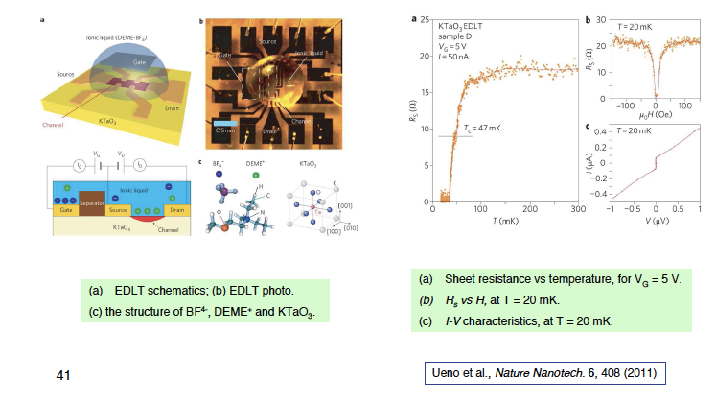
A new superconductor KTaO₃ created by field effect

Slide 27
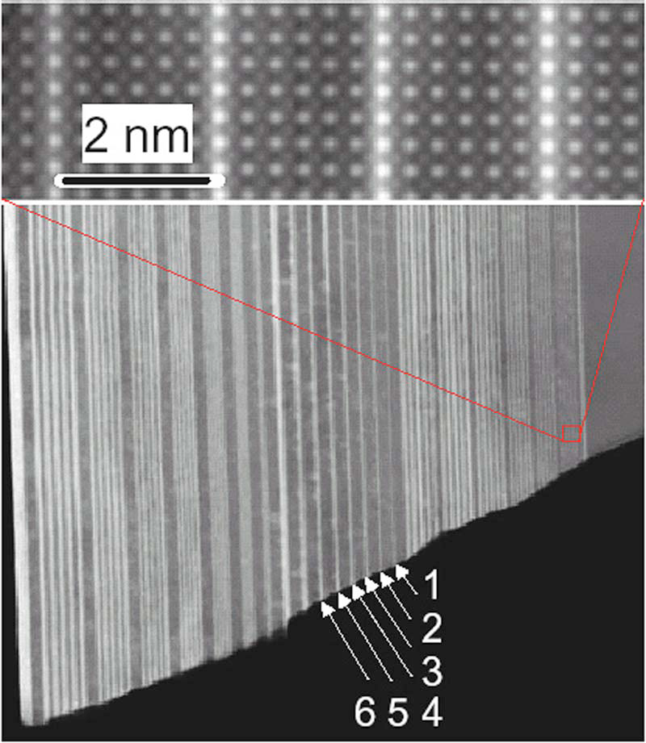
Strategy 6: hybrid of 4 and 5 - Electrolyte upon the MBE
MBE molecular beam epitaxy
LaTiO3 layers (bright lines) of varying thickness separated by
varying thicknesses layers of SrTiO3 (darker regions).
Upper panel: magnified view of the 51 region

Slide 28
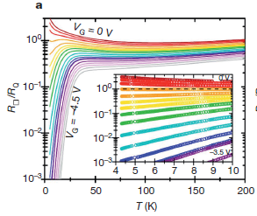
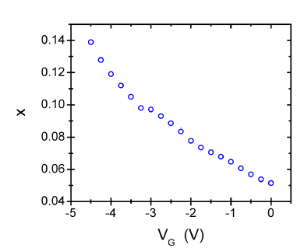
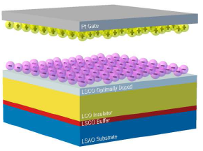
Superconductor–insulator transition in La_{2-x}Sr_{x}CuO₄ at the pair quantum resistance, Nature, 472 (2011) 458 I.Bozovic group
synthesis of epitaxial films of La_{2-x}Sr_{x}CuO₄ (x=0.06 – 0.20) 1, 1.5, 2 unit cell thick, and fabrication of double-layer transistors (NaF+polyethylene glicole)
Optimal doping 0.15
At low concentration SC disappears via Bose glass phase without pair breaking
Achieved: switching off of the superconductivity in a pre-doped material.
Still necessary: turn the SC on from the pristine undoped insulator

Slide 29

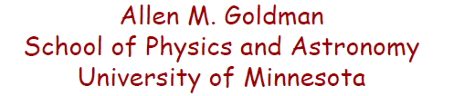
The goals are to deplete carriers and to traverse the transition to the insulator,
to add carriers to cross over the top of the dome and to deplete carriers
for the crossover from the insulator to the electron doped regime.
Notes:
The goals are to deplete carriers and to traverse the transition to the insulator, to add carriers to cross over the top of the dome and to deplete carriers and crossover from the insulator to the electron doped regime.

Slide 30
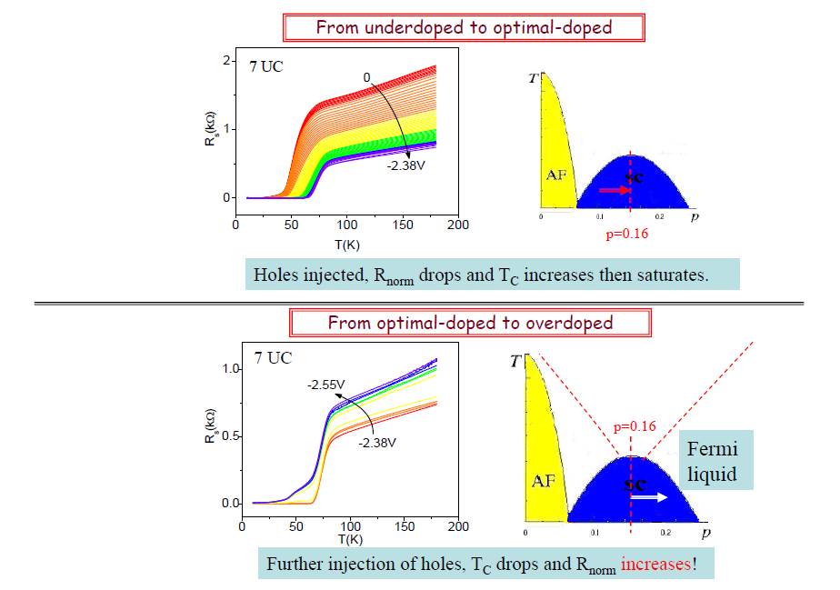
IMPACT-2012

Slide 31
Further depletion of holes
1.52V 0

Slide 32
Explorations of the semi-super-conductivity

Slide 33
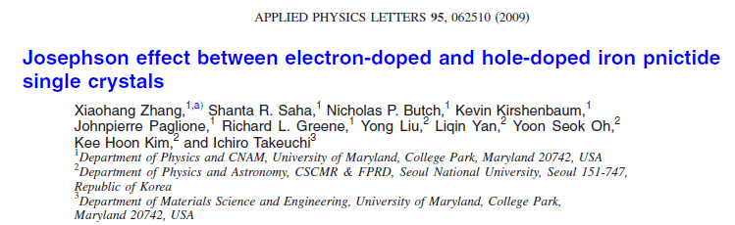
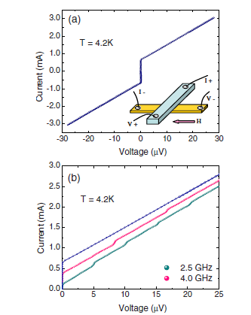
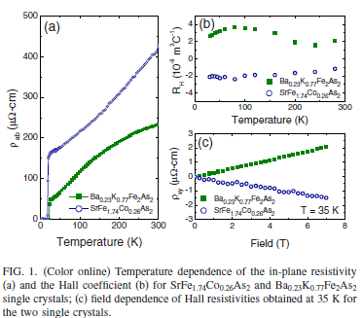
Recall J. Mannhart and A. Baratoff, "Superconducting p-n junctions" 1993 Possibility to explore existence of both n- and p- doped cuprates.

Slide 34
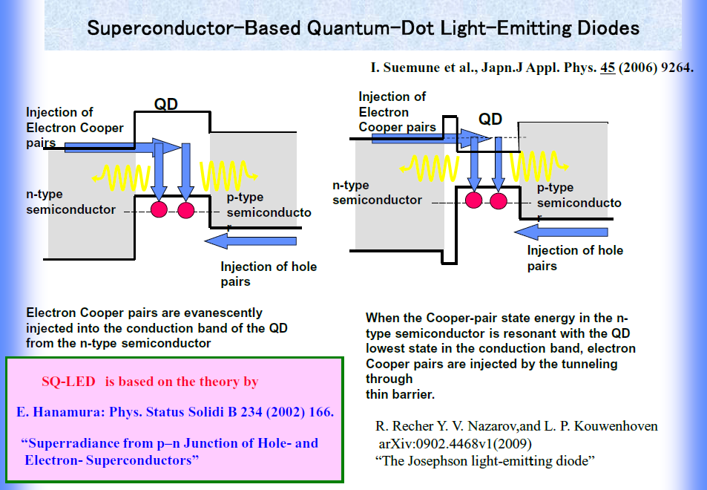

Slide 35
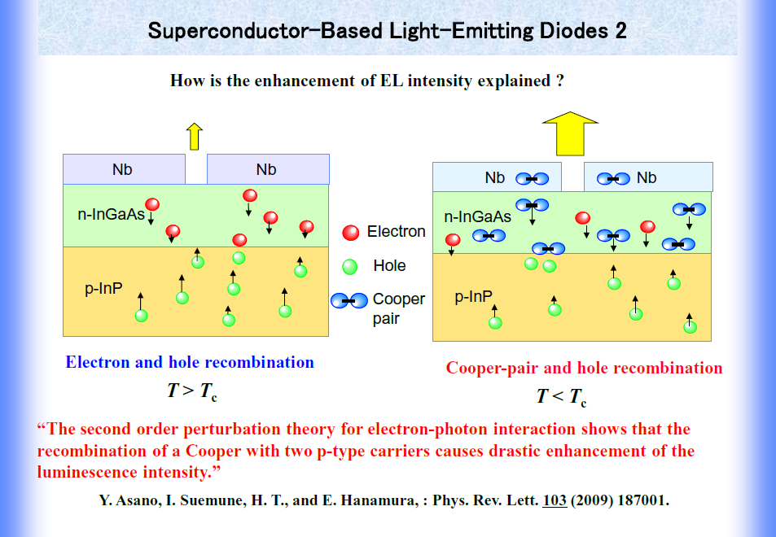
Sapporo Univ., Japan

Slide 36
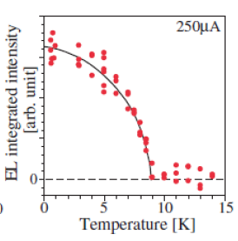
Additional, or even the main, reason for attention:
Two-photon channel of cooper pairs recombination
And these photons are entangled!

Slide 37
Auxiliary Material:
A bit of the old theory

Slide 38
Doped
Polymers
Undoped
Bipolarons:
volume concentration depends on the doping level
But:
dopant induced disorder supresses the possibility Bose condensation also in homogeneous material
A chance for Bose condensation
FET
MOSFET junction allows to introduce charge, hence to create bipolarons on the junction surface
Advantages:
no additional disorder
Problems:
Wigner crystallization
dipole formation
High electric field

Slide 39
Superconductivity from the Bose-condensation of bipolarons or of prefabricated Cooper pairs at the junction surface: after S.B. N.K. and V. Yakovenko , Solid State Commun. 1985
Some theory problems to be solved:
In “conventional” Bose condensation the number of particle is fixed.
In FET the electrochemical potential is monitored by
external electric field – no ideal BEC.
2D ideal gas: Condensation is not allowed in any sense
2D non ideal gas: Bose condensation is possible in a sense of Beresinski-Kosterlitz-Touless
Specific questions:
effects of Coulomb forces
values of the required electric field

Slide 40
Model
ψ₀(z/z₀)
0.5
Formation of the self-consistent potential wall with the single localized eigenstate at the given eigenvalue of μ.
Screening by the single wave function.
Electric field E~10⁷ eV
0
(z/z₀)
10
V(z/z₀)
-1

Slide 41
Conclusions and perspectives
Field effect – electrostatic switching of electronic states at the surface
is well confirmed by diverse experimental methods
The 2D, even monolayer superconductivity does exist
Methodic progress raised the scale of manipulation from mK to 30K
Non realized or unattended issues:
Ambipolar switching
Realization of semi – super devices.
Superconducting p-n junction

