Slide 1
Serguei Brazovskii
CNRS & U. Paris-Sud, Orsay, France
Electronic Phase Transitions Induced by
Electrical and Optical Impacts
Lecture 4
Pump-Induced Phase Transitions

Slide 2
Electronic States and Phases Induced by
Electric or Optical Impacts.
IMPACT-2012, Orsay, France IMPACT-2016, Carges, France
2000’s accelerating mainstream in the condensed matter physics:
IMPACT transformations of cooperative electronic states
under strong external influences. The confluence of two streams:
A. Electrostatic doping = Field-Effect transistor
with extremely high electric fields to reach
a critical surface concentration of carriers.
Main target: switching on or off the superconductivity or the Mott state.
B. Persistent or short-lived transformations
induced by a high power laser pumping.
Ingredients: femto-second resolution pump and probe optics,
pico-second evolution of the transformed states.
Latest versions: Optical pulses followed by the new
time-resolved ARPES or X-ray diffraction.
Next coming jump – atto-seconds.

Slide 3
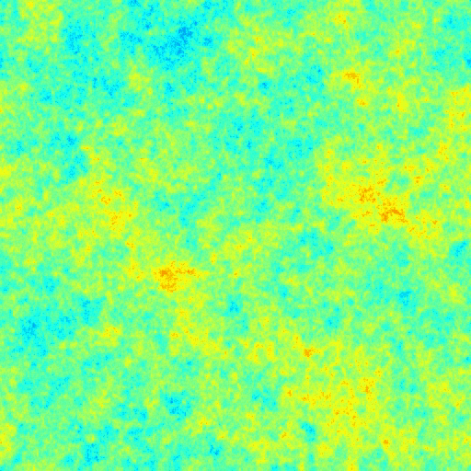
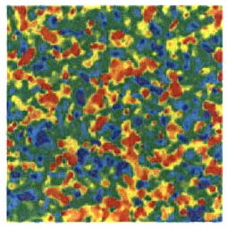
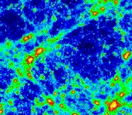
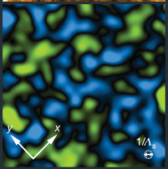
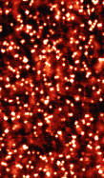
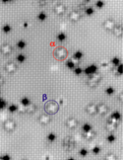
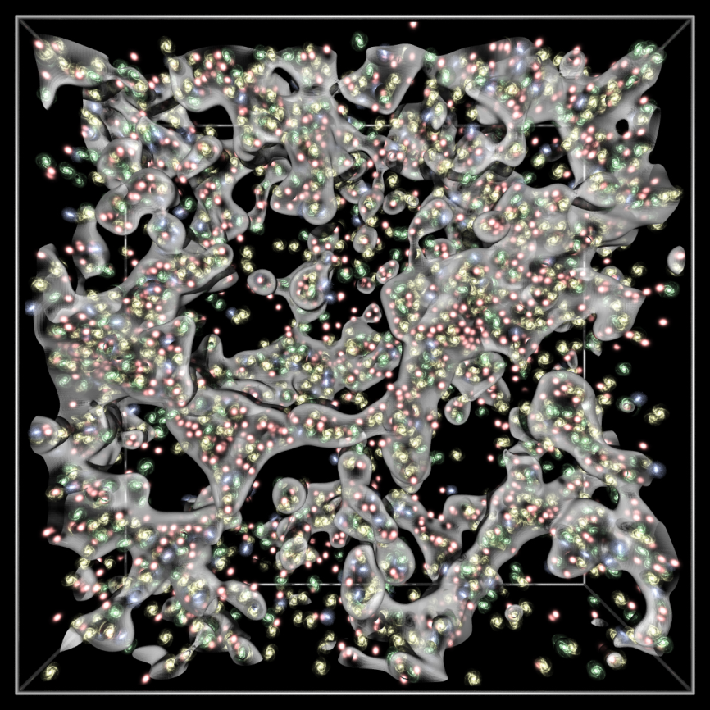
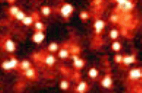
5 of these pictures are STM images of generic disorder -- in high-Tc cuprates and in doped oxides.
But 3 of them have scales of Giga-parsecs rather than nanometers -
this is the sponge-like structure of the Universe:
remnants of either primordial quantum dynamics expanded through
the inflation stage or of macroscopic dynamics of several phase transitions experienced by the cooling Universe -
Higgs field condensation giving particles' masses,
or confinement of quarks and gluons, or
plasma neutralization giving rise to today's MW radiation.

Slide 4
Relevant allusions:
1. Kibble - Zurek scenario of topological defects generation in the universe.
2. Step to condensed matter :
"cosmological" experiments on locally superheated liquid He.
2. Step to ultralow temperatures: cold atoms –
instantaneous modifications of interactions by means of Feshbach resonance
3. Step to strongly correlated materials (Japan priority):
Optically induced Insulator-Metal transition in oxides.
Monitoring of cooperative electronic states by field effect or pumping.
Recent optical manipulations of Charge Ordering in organic conductors.
4. Step to real-time dynamics:
Can we access the strongly non-equilibrium dynamics directly,
rather through its aftermaths?
Yes, with multi-probe femto-second optics –
by now in Charge Density Waves - this talk content.

Slide 5
FEMTO-SECOND PUMP – PROBE TECHNIQUE
Vocabulary: femtosecond fs=10⁻¹⁵ sec – visible light period
Picosecond ps=1/TeraHz=10⁻¹² sec - periods of atomic oscillations
Technique:
pump sharply to a very high (up to 10%) concentration of excitations (electron-hole pairs or bound excitons)
follow the evolution – with a resolution down to 10fs –
by means of fast probes: optics, ARPES, diffraction.
Goals and advantages:
Disentangle fast (10_100 fs) electronic and “slow” (ps) lattice degrees of freedom,
Understand properties of the starting system,
Provoke the dynamic evolution over a wide range of the known phase diagram,
Reach short leaving hidden states unavailable in thermodynamic approaches
Obtain a truly stable hidden state with an unlimited life time

Slide 6
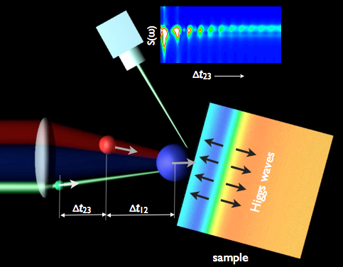
Principle scheme of pump & probe experiments:
Analysis of the sample reactions,
Here we see
coherent quantum oscillations
A- waves
Sample of a material of interest,
usually bearing a cooperative
electronic state.
Pump
May be an additional knock
Versions of pumps:
on-table lasers and/or tera-Hz source for all-optics setups,
a 10²m ring of the synchrotron for the photoemission ARPES,
1km of special ultra-bright light sources for fast X-ray and electron diffraction
Versions of probes and detections:
on-table lasers and tera-Hz detectors for all-optics setups,
ARPES and X-ray detectors

Slide 7
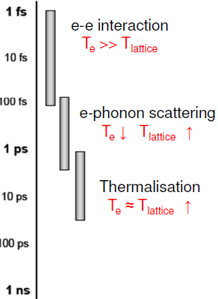
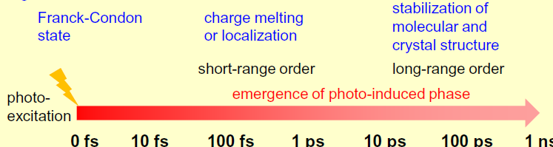
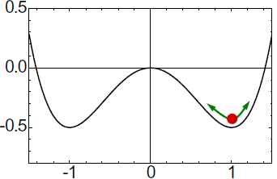
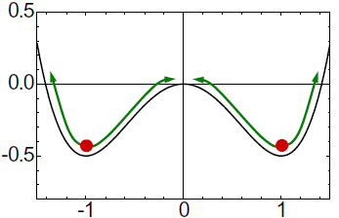
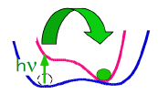
Typical regimes of evolution and their time scales
Low pump, just limited
oscillations around
the initial ground state
Moderate pump, pendulum
oscillations spanning a
variation of stable states
High pump, the former
ground state destroyed
in favor of the new one

Slide 8
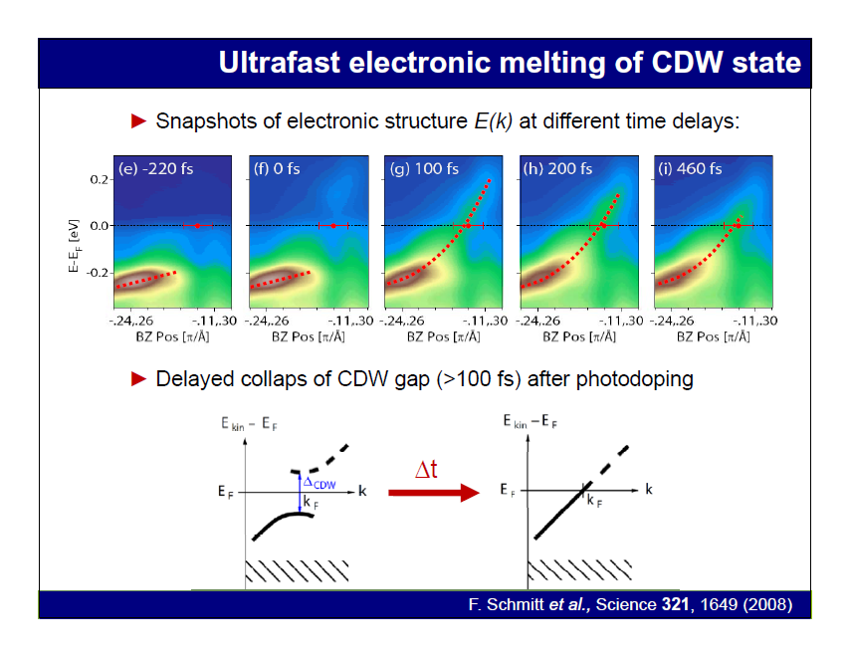
Time resolved ARPES (measuring of the spectral density)

Slide 9
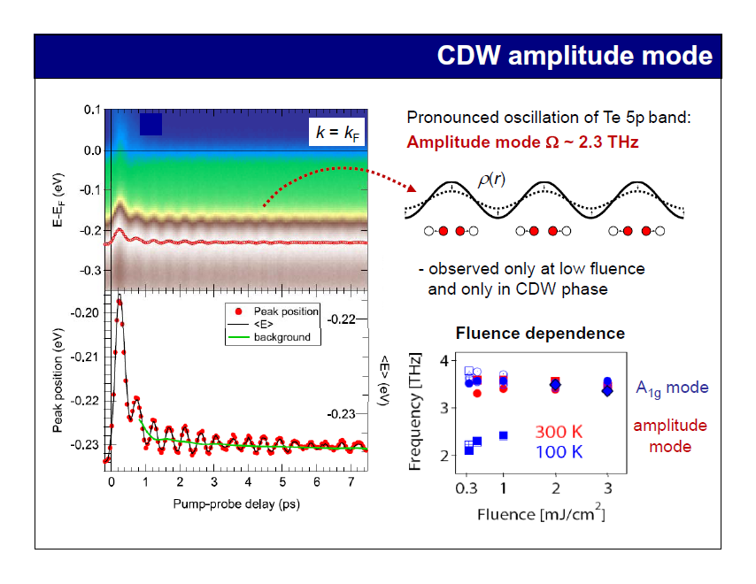

Slide 10
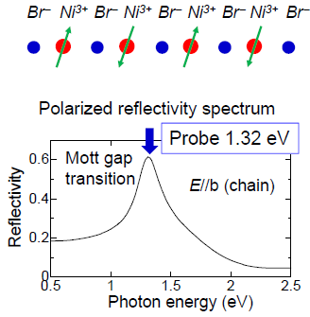
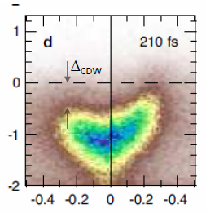
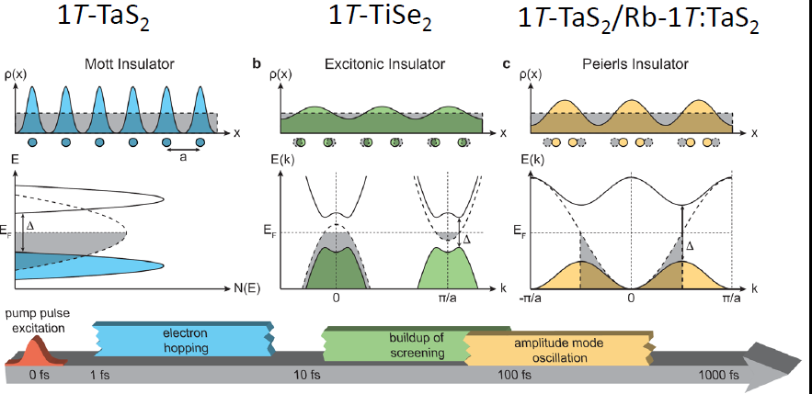

Slide 11
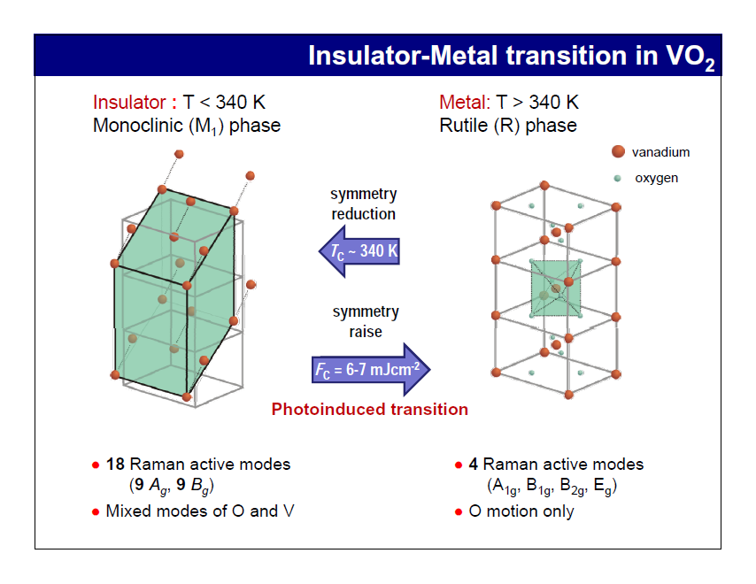
Serving the Mottness socium:
separation of electronic and lattice effects

Slide 12
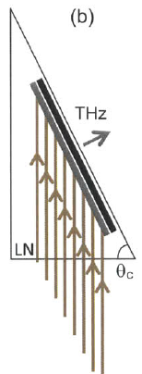
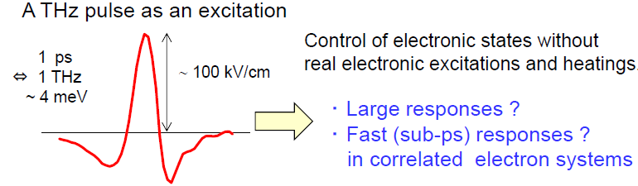
Tera Herz (10¹² Hz =ps⁻¹= 0.1mm)
beyond the 5’th generation of mobile phones.
optical rectiﬁcation of femtosecond pulses
in LiNbO3 using the tilted-pulse-front pumping
10’s mkJ optical pulses of 1ps duration,
the electric field amplitude > MV/cm,
THz pulses focused down to the diffraction limit
Optical group velocity equals the THz phase velocity.
Velocity-matching technique based on femtosecond laser
pulse front tilting for large-area terahertz generation
via optical rectification.

Slide 13
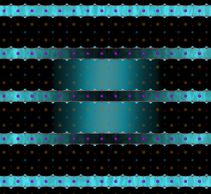
Optically induced superconductivity in cuprates
(A. Cavalieri group at Hamburg)
Light-induced redistribution of interlayer coupling in YBCO.
The pump light enhances the superconducting coupling between the copper-oxygen bilayers at the expense of the superconducting coupling within the copper-oxygen bilayers

Slide 14
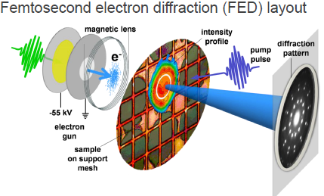

Slide 15
Nonlinear "femto-second" optics - time resolution ~10fs~10⁻¹⁴ sec
Shorter than pico-second scale of phonon's periods 1/ν₀=2π/ω₀~1ps=10⁻¹² sec
empty bands
electrons
optical
pumping
non-equilibrium
e-h population
Spectral gap
holes
filled bands

Slide 16
collaboration with Dragan Mihailovic group
Jozef Stefan Institute, Ljubljana, Slovenia
“Coherent dynamics of macroscopic electronic order through a symmetry breaking transition”, Nature Physics 2010.
“Ultrafast switching to a stable hidden quantum state in an electronic crystal”, Science 2014.
“Controlling the metal-to-insulator relaxation of the metastable
hidden quantum state in 1T-TaS2”, Science Advances 2015
“Fast non-thermal switching between macroscopic charge-ordered quantum states induced by charge injection”.
Nature Comm., to be pbl.

Slide 17
Femtosecond coherent nonequilibrium electronic ordering and topological defect dynamics in Charge Density Waves.
R. Yusupov, T. Mertelj, V.V. Kabanov, P. Kusar, D. Mihailovic
Jozef Stefan Institute, Ljubljana, Slovenia
P. Kusar, J.-H. Chu, I. R. Fisher
Applied Physics, Stanford University, USA
S. Brazovskii,
CNRS&U. Paris-Sud, Orsay, France
Nature Physics, 2010
Real-time probe of evolving
ground state via phonon modes and electronic relaxation
A- waves

Slide 18
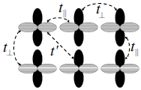
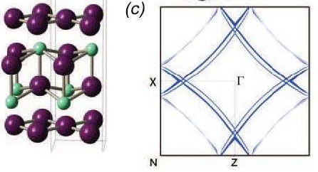
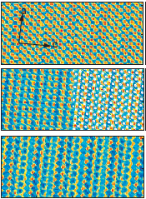
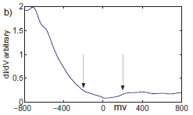
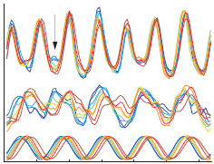
Layered compounds with Charge Density Waves: Tb(Dy)Te₃, TaSe₂, K_{0.3}MoO₃
Fermi surfaces from
ARPES experiments
Strongly oriented molecular orbitals →
hidden one-dimensionality in two orthogonal directions →
flattened, nearly nested Fermi surfaces →
instability towards an incommensurate CDW, wave number Q=0.7→
gap closes some ½ of the Fermi surface
total modulation
extracted CDW overlap
STM Studies of TbTe3: Evidence for a fully Incommensurate
Charge Density Wave A. Fang, et al, Stanford

Slide 19

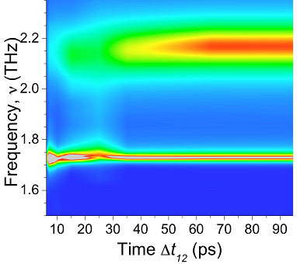

The way all have started; no fine structure yet
Amplitude mode AM
of the order parameter
Inter-mode interaction
when one acquires a width
Reference auxiliary mode
noninteracting with electrons
Original challenge:
Why does the AM sets in with a delay 10-times
longer than the relaxation time of electrons ~2ps?
Why does it stay broadened for ever?
Suspected: creation of topological defects,
hence links to aftermaths of to dynamical phase transitions.
Discovered reality – dynamic "primordial"regime.

Slide 20
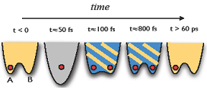
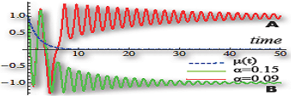
1
2
3
4
5
Time evolution of the ground state energy profile as function of the order parameter.
Red dot - the system state.
Time evolution of the system state at 2 close values of the
damping parameter α.
1. Starting state at t<0: symmetry broken, at one of allowed minima – here at A=-1.
2. After the distraction: no more nontrivial energy minimum,
the high energy with respect to the new profile initiates pendulum oscillations.
3. Friction reduces the energy of oscillations.
The same time the relaxation of non-equilibrium fermions allows
to work out nontrivial minima – still too shallow with respect to oscillations energy.
4. Approaching the dynamical phase transition. The decreasing energy and the growing barrier meet each other: the critical slowing-down.
5. The trapping to one of the symmetry broken states.
Gradually vanishing oscillations near the new state.

Slide 21
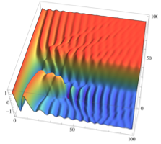
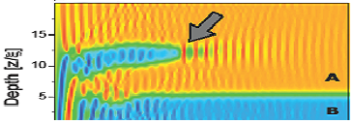
Evolution of the ground state energy profile.
Red dot - the system state.
Spacio-temporal modeling with experimental parameters
afterwaves
Annihilation
event
Depth z
Annihilation event
domain wall
A(t,z)
afer waves
time
delay time
Collapse of domains by annihilation of domain walls.
Ripples in the space-time texture are due to annihilation events.

Slide 22
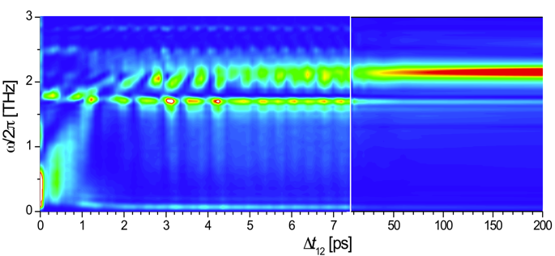
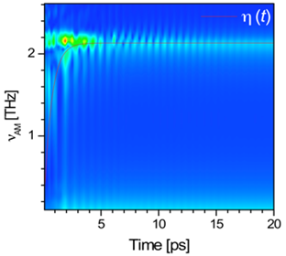

Theory versus Experiment
White arrows –
distortion due to "Higgs waves" emitted by annihilations of domains.
Red arrows - slowing down below the critical time of the trapping t_{c}.
Notice softening of the amplitude mode AM in the distracted interval.
Numerical solution integrated over z
Experimental spectrum
tc
tc
Δt12
FFT power spectra as a function of t₁₂. Note:
non-periodic fluctuations of intensity around the traping t_{c}=1.5 ps,
asymmetric line shapes near t₁₂=3.5ps as the domain wall
reaches the surface (white arrows).

Slide 23
All that came from a numerical time-space solution of just
an absolutely minimal GL model for the order parameter A(t,z).
Electrons are present implicitly via the parameter a(t,z) controlling the deviation from the phase transition point a=0.
z – coordinate down from the surface. η destruction strength.
ξ – inter-plane coupling length. λ – light's penetration depth.

Slide 24

Unattended questions.
Micro-scale:
Can we envisage an anomalous conversion between
the nonequilibrium normal carriers and the condensate
when the gap passes through zero?
2. Macro-scale:
The order parameter of the incommensurate CDW ~Acos(QR+ᵠ)
is a complex function Aexp(iᵠ) .
Can the purely amplitude pendulum oscillations be unstable
with respect to the phase rotations, hence provoking
the originally expected long living 2π vortex configurations?
3. Macro-to-Micro scales:
Can the domain walls of the amplitude be dressed
by π-vortices of phase rotations allowing for
their smoother shrinking rather than annihilation?

Slide 25
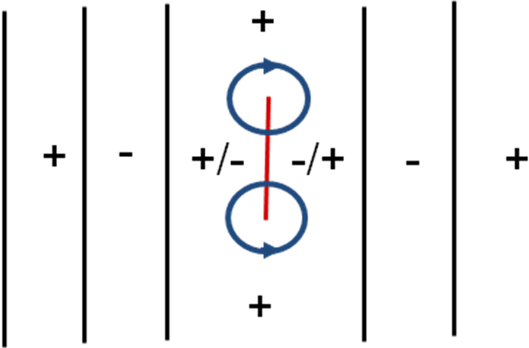
link to combine topological defects in doped AFM and strained ICDW
link to melting of FFLO phases in spin-polarized superconductors.
Normal vortex is spontaneously split
in two 1/2 vortices with the A=0 string
rising in-between. (Osaka group)
ψ=Aexp(iᵠ)
A→-A ≡ ᵠ→ᵠ+π
Defect is embedded into the stripe structure (black lines). +/- are the signs of the order parameter amplitude. Termination points of a finite segment L (red color) of the zero line must be encircled by semi-vortices of the
π rotation (blue circles) to resolve the signs conflict.

