Slide 1
Dynamical patterns of phase transformations from self-trapping of quantum excitons.
after collaboration with Natasha Kirova
Incentives from experiments in Tokyo (H. Okamoto)
Based on writing for the anniversary volume of JETP
devoted to 85 years of L.V. Keldysh
Hence the excitonic insulator, excitons and their condensate.

Slide 2
PUMPING TO EXCITONS - OUTLINE
Introduction. Time resolved phase transformations induced by optical pumping of excitons in a media prone to an instability.
The workshop of excitons in donor-acceptor chains with
neutral-ionic transitions.
Intramolecular excitons interacting with the order parameter:
Spacio-temporal evolution: space segregation from self-focusing. Local dynamic transitions at subcritical pumping.
Charge transfer excitons merging with the order parameter:
Entangled Bose condensation of excitons and the Excitonic Insulator transition for the thermodynamic order parameter.
Coherent oscillations from quantum interference in the excitonic condensate and the excitonic insulator ground state.
Conclusions, confusions, unsolved problems.

Slide 3
10’s fs
100 fs
empty bands
non-equilibrium populations
of electrons e and holes h.
electrons
Spectral gap
or bottleneck
Alternative:
subgap pumping
to excitons –
e-h bound states
optical
pumping
holes
filled bands
At high density and cooled, excitons might form a quasi-condensate.
Wave function Ψ of this macroscopic quantum state evolves
interacting with other degrees of freedom prone to instability.
Ψ is subject to self-trapping (akin to self-focusing of light).
Locally enhanced density can trigger the phase transformation,
even if the mean density is below the global threshold.

Slide 4
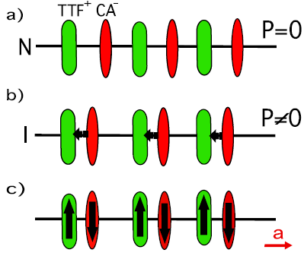
Neutral-Ionic Transition in donor-acceptor chains.
TTF-CA: stacks of alternating
donors D=TTF and acceptors A=CA.
T>Tc=81 K: molecules are weakly charged.
T=Tc: quasi-neutral to ionic transition – 1st order.
Charge transfer ρ jumps from ρ_{n} =0.32 to ρ_{i} = 0.52
Charged molecules shift relative to each other – Coulomb or spin-Peierls instabilities:
alternation of long and short bonds.
With all inversion and mirror symmetries
lifted, this is the electronic ferroelectric.
Tokura teams, Nagaosa, Koshihara and Okamoto, Luty , Caileux
Thermodynamic charge transfer. Primary effect: redistribution of the charge density ρ with no symmetry breaking -
an isomorphic transition described by the single real field r = ρ - ρ_{n}.
Actually – symmetry breaking because of the complementary dimerization;
Still of the 1st order by influence of ρ

Slide 5
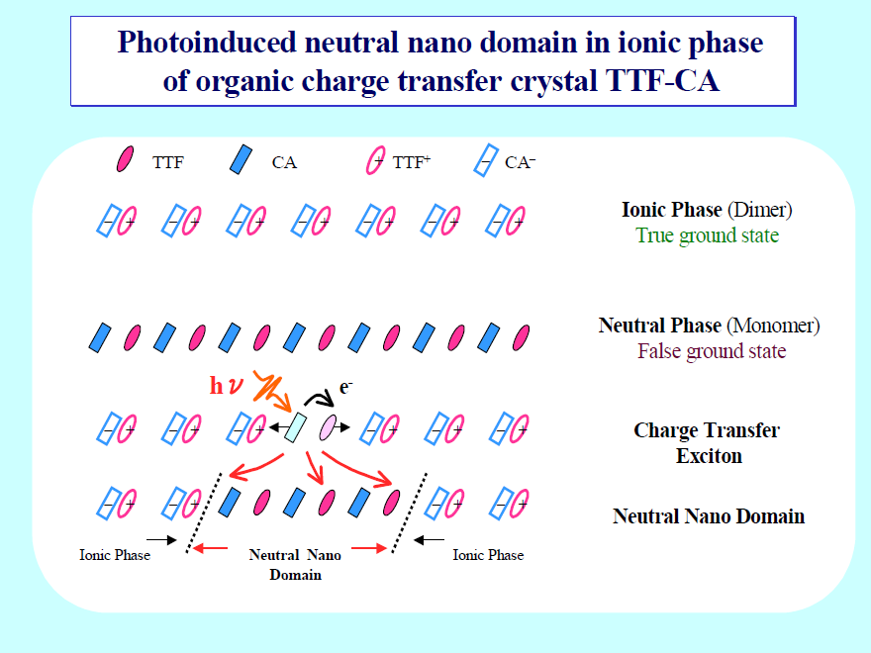
Common picture: phase transitions via formation of strings and walls.
Well accepted in equilibrium, its shown here wide use in dynamics assumes the light absorption by a single molecule or a dimer.
Contradiction to the optical exciton as a delocalized quantum wave with the momentum p=0. Our view: selftraping rather than domino.

Slide 6
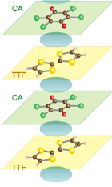
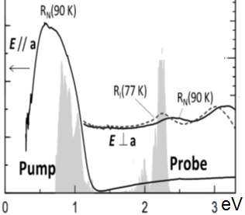
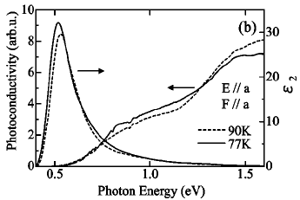
Donor-acceptor chains - workshop for pumping of excitons
Intra-molecular excitons IME (S. Koshihara)
Pumping into the IME : the excitons and the order parameter are different while interacting fields.
CTE,
0.6 eV
Inter-molecular = charge-transfer excitons
CTE (H. Okamoto). Both the exciton and the charge ordering are built from processes of electronic transfer with a density ρ= ρ_{n}+r between donor and acceptor molecules.
IME,
2.4 eV

Slide 7
EXCITONS and PHOTO INDUCED PHASE TRANSITIONS
Resonance pumping to excitons or
Intermediate stage after the electronic pumping.
Excitons:
initially delocalized (photon k=0)
High density, a quasi-condensate, a macroscopic quantum state.
Wave function Ψ which evolves interacting with other degrees of freedom prone to instability.
Subject to self-trapping (akin to self-focusing of light).
Locally enhanced density can trigger the phase transformation, even if the mean density is below the global threshold.
N.B. Exciton is a quantum state in both the internal and the center of mass coordinats

Slide 8
Charge Transfer Excitons pumped in a media prone to
the Charge Transfer instability.
Both the exciton and the charge ordering are built from processes of electronic transfer between donor and acceptor molecules.
Thermodynamic order parameter and intensity of pumped excitation are of the same origin.
Density of excitons q=|Ψ|² is not distinguishable from
the thermodynamic order parameter r=ρ- ρ_{n}.
To treat both thermodynamic and dynamic effects on the same root, we adopt for the phase transition a view of the Excitonic Insulator (EI).
1960’s: Knox, Cloizeau, Kohn et al, Halperin and Rice,
Keldysh et al, Kozlov and Maksimov
- well revived nowadays experimentally and in theory.
EI is a nickname of a hypothetical phase of
a semiconductor which appears if the total energy of an exciton E_{ex}=E_{g}-E_{b} vanishes: E_{ex}→0.
E_{g}
E_{b}
E_{ex}
0

Slide 9
Excitonic insulator – instability when the exciton energy goes to zero.
The most general concept E_{ex}=0 covers
all non-metallic quantum phase transitions.
The focused concept of the EI is distinguished when the number of excitons, both in the ground state and out-of-equilibrium,
is approximately conserved.
(If it were conserved precisely, then there would be no dynamical path to the EI state which is of particular importance in the context of PIPT.)
Microscopic theories of the Bose condensate of pumped excitons and of the EI transition are closely related, differing mostly by monitoring parameters: the chemical potential μ_{ex} and the density n_{ex}.
That allows to build a model describing jointly the dynamics of excitons and the evolution of the phase transition after the pumping.

Slide 10
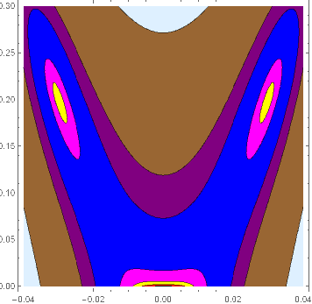
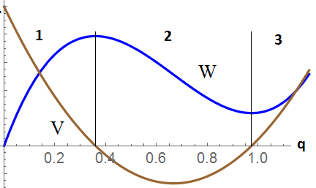
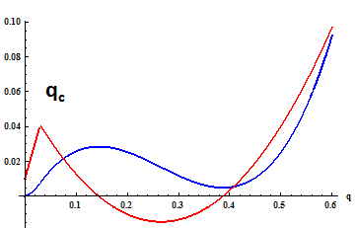
The minimal model for the CTE
interacting with the symmetry breaking order. The energy W(q,h) :
q
q – charge transfer
= excitons’ density
h – lattice deformation
q_{c} – critical value of q to initiate h
h
excitons’
attraction
excitons’
creation
V(q)
Energy W(q,h)→W*(q) and the potential V(q,h)→V*(q) after minimization over h. V=dW/dq
W(q)
4 intervals of q: repulsion, attraction, creation, repulsion of excitons

Slide 11
Enigma: thermodynamic charge transfer =
redistribution of the charge density q
is a single real non-conserved field.
Charge transfer under pumping
is the ≈ conserved field q=||²
 = || exp(i) :
the phase  - appears as a hidden degree of freedom.

Slide 12
Resolution with a hint from (Keldysh and Kozlov, 1972)
Take into account additionally:
Matrix element of Coulomb interactions transferring two electrons across the gap, from filled to empty band =
simultaneous creation or annihilation of two e-h pairs
→ creation/destruction of excitons’ pairs from/to the vacuum.
These virtual transitions become real for macroscopic concentration.
normal -> E_{ex}|ψ|²
anomalous -> S(ψ² +ψ*² )
e
e
e
h
h
h
h
e
S-term fixes the wave function phase in the EI ground state.
Dynamically it gives rise to oscillations of quantum interference among states which numbers of excitons differ by 2.

Slide 13
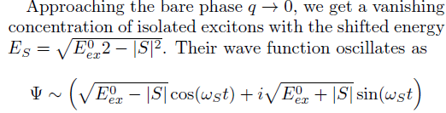
-

Slide 14
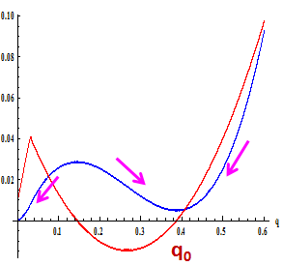
Generalized Gross-Pitaevskii eq. for evolution of excitons’ wave function
(q,h) = decay/creation rate for the excitons’ density q:
1. constant at q→0 (single-particle recombination) – neglect in modeling,
2.  q at moderate q (BE statistics - stimulated emission),
3. vanishes in the minimum of W at q≈q₀ - no way to release
the energy, hence the guess as Γ V(q) if S=0.
The interpolation Γ(q,h)  qV(q,h) ensures the relaxation
towards the local energy minimas at q→0 and at q→q₀.
At S≠0, with the phase dependence: the generalization:
V(q)
W(q)

Slide 15
No space dependence: a homogeneous regime or multi-stable quantum dot - switching by absorbing the exciton, polar variables:
Γ describes the relaxation of the amplitude.
S-term gives rise to either locking of the phase
approaching the EI phase, when |V|<S ,
or to oscillations of quantum interference among
states which numbers of excitons differ by 2.

Slide 16
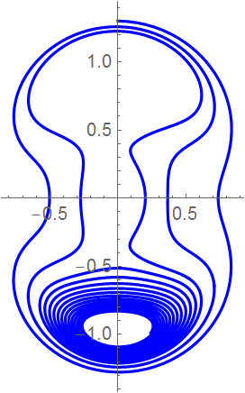
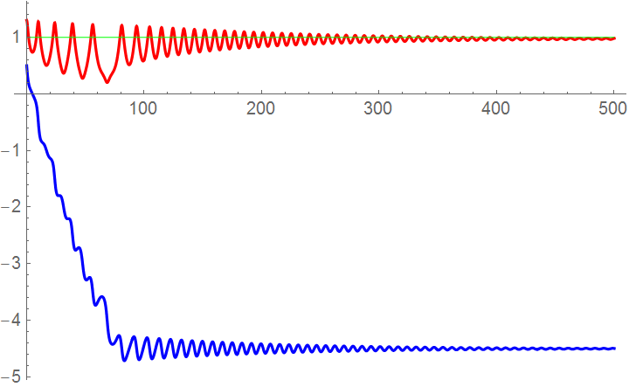
Pumping to the EI state. Generic model- no lattice component h.
Case of the first order phase transition. High pumping.
Oscillations from the macroscopic quantum interference
and dynamic lock-in transition back to the EI.
Locked EI
BEC
evolution
  Time dependence of q(t), ϕ(t) and the polar trajectory q(ϕ) for the generic EI after an additional pumping. ϕ gets an increment 2 π

Slide 17
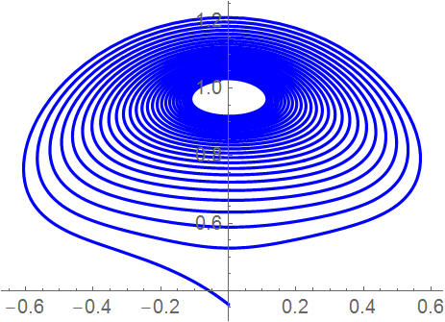
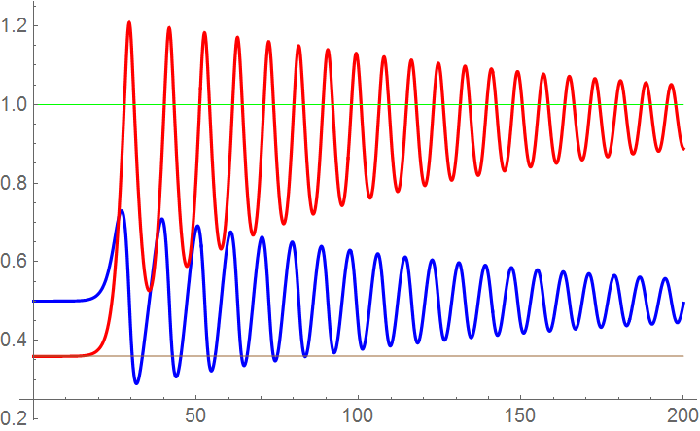
Generic model - no lattice contribution.
Case of the first order phase transition, critical pumping.
Oscillations from the macroscopic quantum interference
and dynamic lock-in transition from the virgin to the EI state.
q
ϕ
Time dependencies and the polar trajectory towards the metastable EI after a just super-barrier pumping of the virgin state.

Slide 18
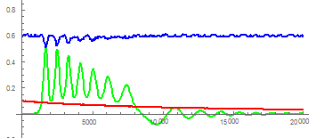
Complete model.
Strong unharmonic lattice oscillations are generated.
E_{ex}
100h
10q
t (fs)
S=0.01 Subcritical pumping.
In spite of the strong initial perturbation, q and h vain at large t.
Small oscillations (tripling) of the exciton energy
appear from the macroscopic quantum interference:
excitons’ pair creation from the vacuum

Slide 19
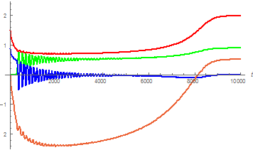
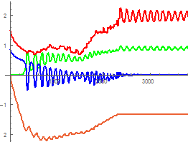
Supercritical pumping: q rises above the initial pumping level
by generation of excitons from the vacuum.
S=0: q and h reach smoothly the equilibrium values of the EI state.
ϕ also saturates (E_{ex}→0 !) at an arbitrary value.
S≠0: stronger and unharmonic oscillations at intermediate times.
Sharp lock-in transition of the phase spikes
the new set of strong oscillations.
S=0.01
S=0
10q
10q
30h
30h
E_{ex}/2
t
t
E_{ex}/2
ϕ/100π
ϕ/100π

Slide 20
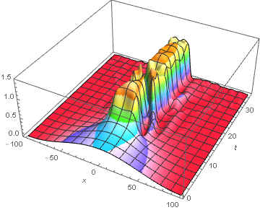
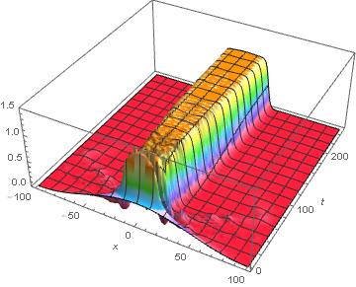
Space-time modeling, intermediate pumping, S=0:

Slide 21
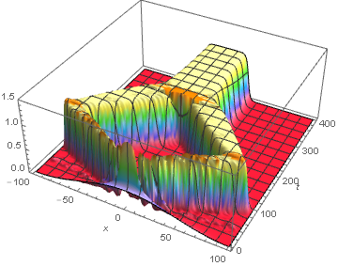
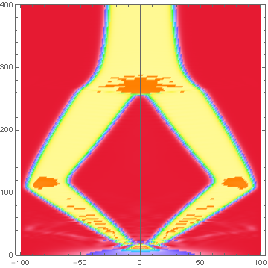
Space-time modeling, just super-critical pumping, S=0:

Slide 22
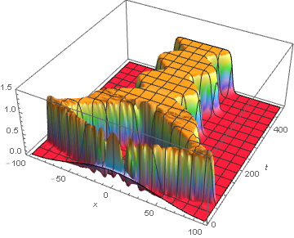
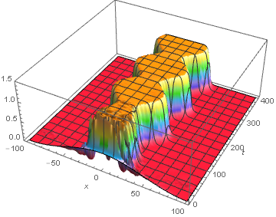
Space-time modeling, super-critical and higher pumping, S ≠ 0:

Slide 23
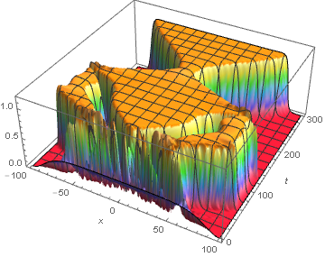
Flat initial conditions – triple walls

Slide 24
Conclusions
Intra-molecular and charge transfer excitons
A quasi-condensate of optically pumped excitons appears
as a macroscopic quantum state.
It evolves interacting with other degrees of freedom prone to instability, with self-trapping of excitons akin to self-focusing in optics.
The locally enhanced density of excitons can surpass a critical value to trigger the phase transformation, even if the mean density is below the required threshold.
The system is stratified in domains which evolve through dynamical phase transitions and may persist even after the excitons recombine.
Charge transfer excitons
The excitation and the long range ordering can be built from
the same intermolecular electronic transfer.
Both thermodynamic and dynamic effects can be described on the same root by viewing the ordered state as the Excitonic Insulator.

