Slide 1
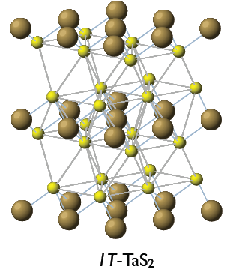
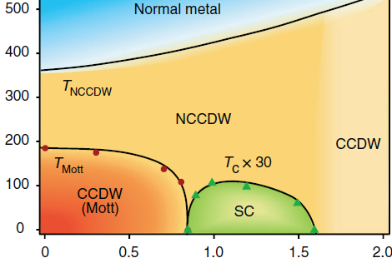
40 years old mystery of TaS2 and 1-2 years old recent progress
ICDW
TaS_{2-x}Se_{x}
R

Slide 2
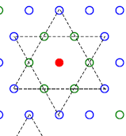
1T-TaS2 – microscopic foundations (disputable).
Background: narrow-gap (E_{g} =Δ_{e}+Δ_{h}≈0.6eV as from older STS) insulator formed from parent metal (with 1e per Ta site) by a high-T (>500K) CDW.
Incomplete nesting leaves each 13-th electron ungaped which
in a typical CDWs would give rise to a pocket of carriers.
Here, each excess carrier is self-trapped by inwards displacements of the surrounding atomic hexagon (forming the “David star” unit)
which gives rise to the intragap local level accommodating this electron.
These charged heavy polarons inevitably arrange into the Wigner crystal
which is always a hexagonal super-lattice –
by Nature chance upon the underlying hexagonal lattice
This ideal locked form is the C phase.

Slide 3
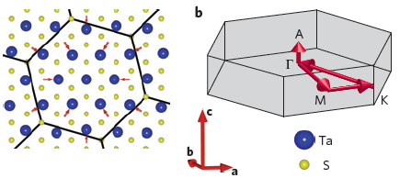

Slide 4
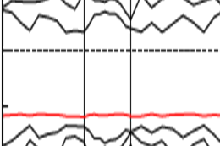
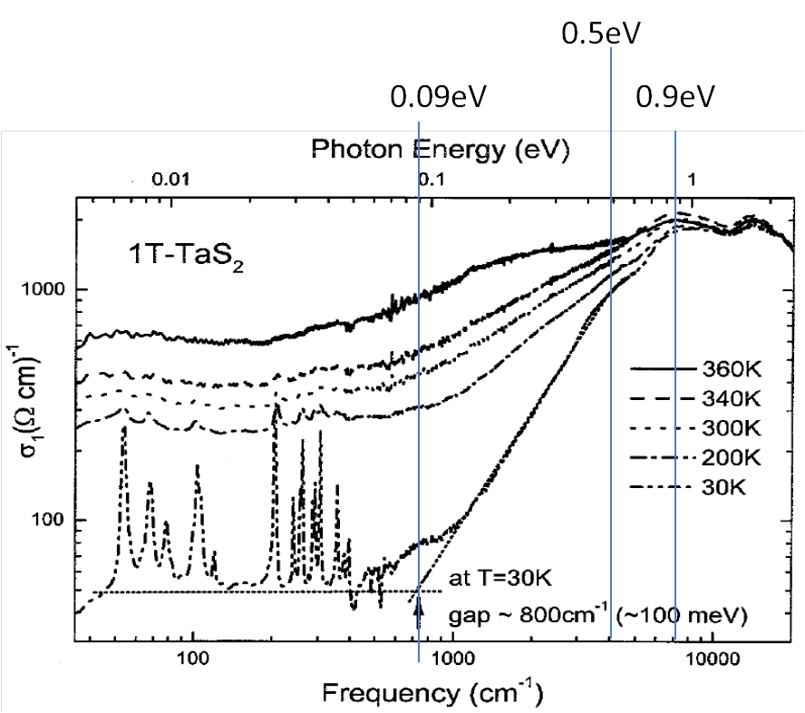
This is the Mott insulator because adding another electron will require for the Hubbard repulsion energy U which is of the order E_{g}.
The hexagonal arrangement is frustrating for spins thus preventing their AFM or other ordering which make it an ideal stage for the “Mottness” (1976, Tosatti and Fazekas – as also “Andersonness”).
Position of the UHB with respect to electronic band bottom at E_{g}
and their hybridization was a major unresolved issue
(not anymore after CALDES STS)
UHB
E_{F}
E_{g}
LHB
Optics, Gasparov et al., (2002).

Slide 5
Exciting the self-trapped electron from the intragap level
deprives the deformations from reasons of existence,
the David star levels out in favor of a void in the WC while the electron is sent to a higher delocalized band or recombines with a band hole.
Adding an electron to the UHB may lead to a stable bipolaron,
but the energy cost most probably will not allow for its stability.
Mitosis into two polarons will proceed thus creating an interstitial in the WC – both voids and interstitials have been seen by STM.

Slide 6
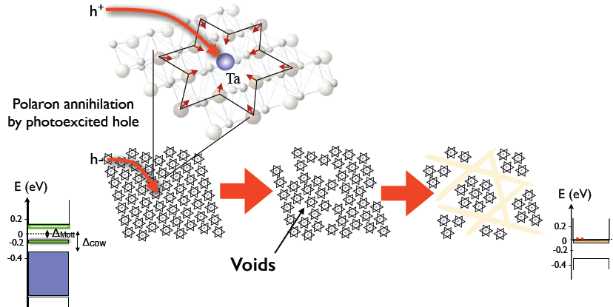
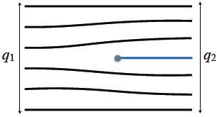
Photo-doping and ordering of voids
Addition of h+ to the C structure annihilates a polaron, creating a defect.
Proliferating (climb) of edge dislocations
performs two functions:
Release the degree of the IC,
Absorb defects (voids)

Slide 7
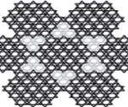

Phase separation:
voids are expelled in-between dense
clusters yielding the NC phase.
If not expelled, then the walls’ melting
gives rise to the IC phase seen at higher T.
Such a self-tuned Wigner-Mott state stays
always, even under doping, in half-filled MI regime:
number of sites is regulated to adjust to the number of electrons.
(common notion in CDWs)
There is no such a thing here as the dopped Mott insulator;
this is a Wigner crystal with (expelled) defects.

Slide 8
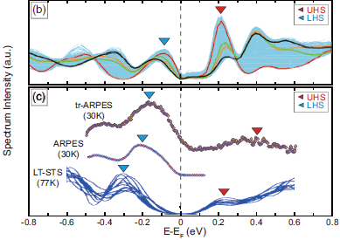
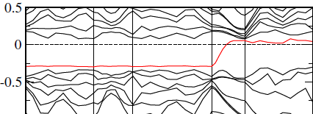
“The Importance of Being Earnest” – Oscar Wild
From a new standard of the STM (H.W. Yeom group, 2015):
CDW and the Mott gap as
0.20-0.24 eV and 0.32 eV
Cf. the old 0.6eV

Slide 9
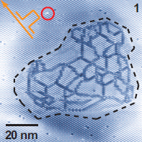
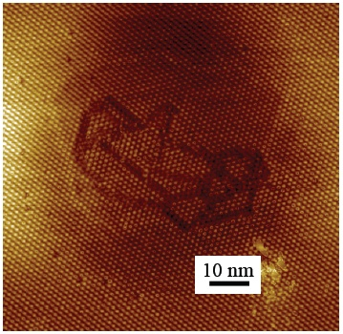
A breakthrough – another 2015
work from H.W. Yeom group (Ncomm).
Generation of domain walls’ globe
by application of the STM pulse
The confirmation from
D. Mihailovic group
(Nature Comm. 2016, SI)

Slide 10
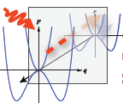
Modeling of evolution of a complex electronic system to a stable hidden state:
application to optical quench in TaS2.
After collaboration at Ljubljana with D. Mihailovic group
Science Mag. 2014
Quest for the :Hidden States

Slide 11
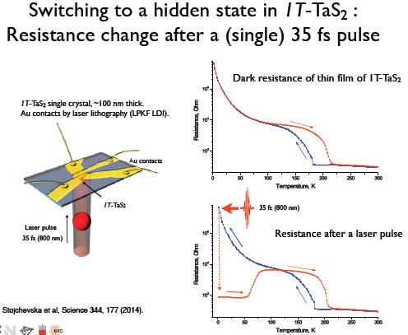
Taken from a presentation by D. Mihailovic

Slide 12
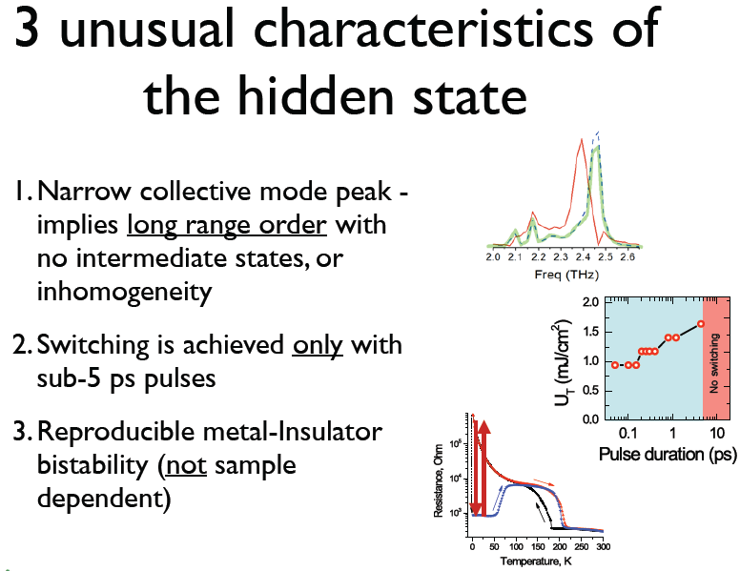
Taken from a presentation by D. Mihailovic

Slide 13
Quasi-equilibrium states and rates of equilibration are determined by
the game of partial chemical potentials for each reservoir of electrons.
For band states near rims of the band gap – free 2D electrons:
DOS
μ_{e}
Example:
μ_{e}> Δ_{e} – degenerate Fermi gas of electrons
|μ_{h}|< Δ_{h} -- thermal activation, Boltzmann gas of holes
Δ_{e}
-μ_{h}
-Δ_{h}

Slide 14
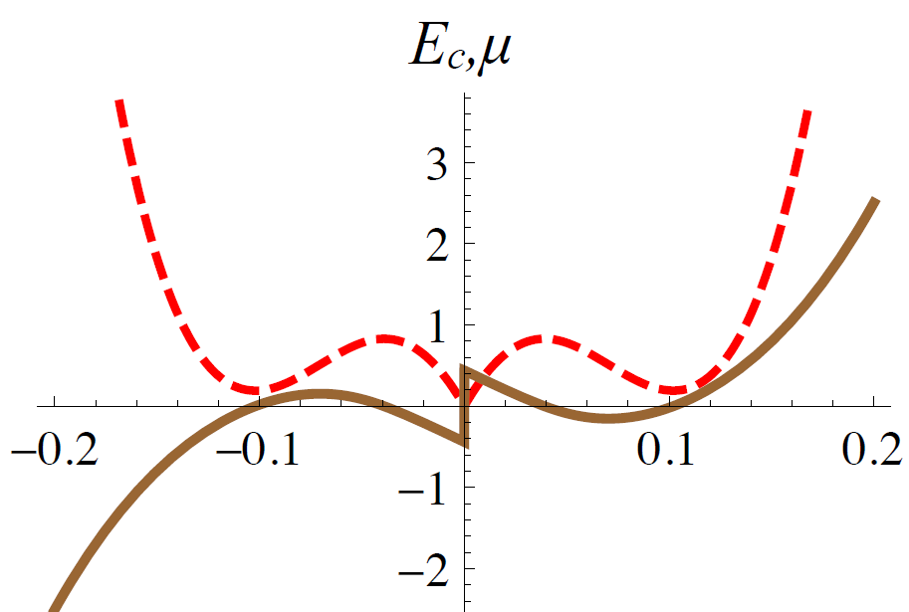
For defects, we adopt the scheme of incommensurable superlattices.
That could be any double-well curve for the energy to give rise
to a 1st order C-IC transition or
its numeric precision from the GL studies (Nakanishi);
Our choice – a qualitative theory by Bak and Villain
where the 1st order is explained as effect of crossings of domain walls.
F_{d} and the chemical potential μ_{d}=dF_{d} /dn_{d} as functions of defects concentration:
n_{d} =voids – interstitials.
Conservation law of electrons:
n_{e}-n_{h} = n_{v}-n_{i}= n_{d}

Slide 15
F_{d} (n_{d}) is the basic energy of the IC state with respect to the C one.
Stabilizing walls repulsion
Energy <0 of walls crossings
C₀<0 drives to IC instability:
Conventional 2nd order
C-IC transition
Repulsion of crossings

Slide 16
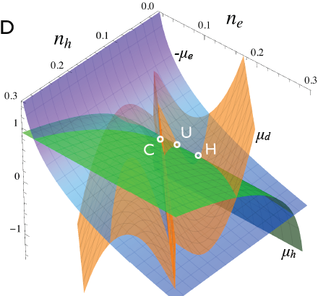
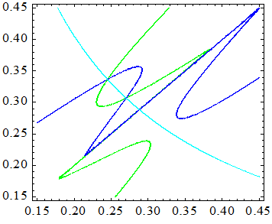
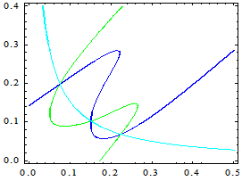
μ_{e}(n_{e})=-μ_{h}(n_{h})
H
U
C
Chemical potential surfaces -μ_{e}(n_{e}) , μ_{h}(n_{h}), μ_{d} (n_{e}-n_{h})
C,U,H are triple intersections where -μ_{e}(n_{e})= μ_{h}(n_{h})=μ_{d} (n_{e}-n_{h}).
C and H are local equilibriums under constraint n_{e}-n_{h} = n_{d}.
In C, n_{e}=n_{h ,} n_{d}=0; points H and U are IC states,
Point U of the energy maximum is repulsive.
Variations of parameters and temperature
can change plot's topology.
No C-phase

Slide 17
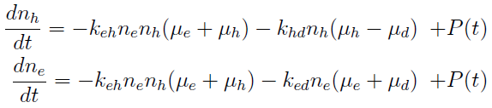
Rates eqs. for concentrations are designed minimalistically -
just to satisfy the requirement that binary rates pass through zero when chemical potentials become equal.
Here k_{ij} are just constants but they may be T-dependent.
μ_{i} = μ_{i} (n_{i},T) are T-dependent for sure, so a need to add an eq. for the evolution of T→T_{e}(t) – the electronic temperature.
T branches to the electronic T_{e} for μ_{e} , μ_{h} and the lattice one for μ_{d}
To cover shorter times, these rates eqs. should be generalized to kinetic eqs.

Slide 18
Advantage of our accent upon μ’s : we know the power
released by processes of electronic transformations:
T_{e}(t) and T_{l}(t) are time dependent; they are determined from an additional eq. of the thermal balance.
The heating source is not only the pumping pulse P(t)
but also the energy W released by electronic transformations.

Slide 19
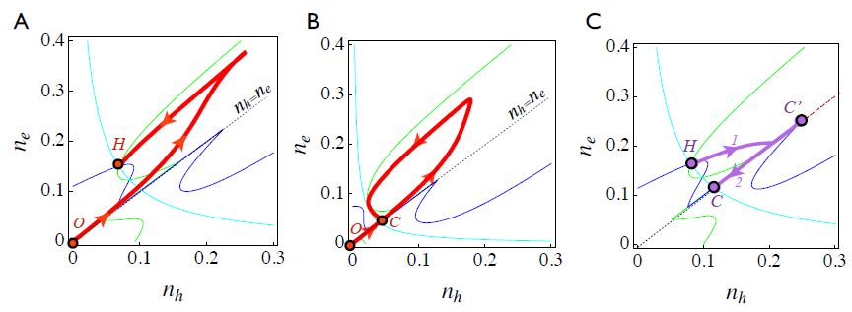
Trajectories - parametric plots of n_{e}(t) and n_{h}(t) superimposed on lines
of partial equilibriums given by intersections μ_{e} =- μ_{d} , μ_{h} = μ_{d} , μ_{e} = -μ_{h}
- drawn for the final temperature after the system has stabilized.
A: Above the switching threshold U>U_{T} - reaching the H-state
B: Below threshold U<U_{T}. The system returns to the C state.
C: Erasure by heating in the H-state .
Trajectory first leaves the H-point, then joins the commensurate line.
After reaching a maximum C', on cooling the system returns to point C.

Slide 20
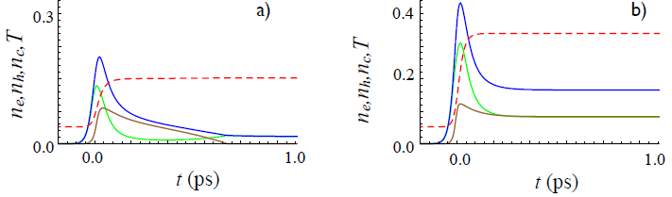
T_{e}
a) Below threshold: n_{e}→n_{h} , n_{d} →0
b) Switching

Slide 21
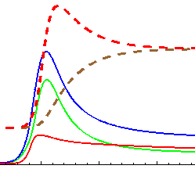
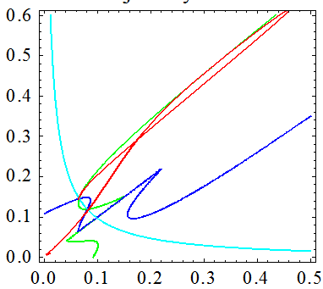
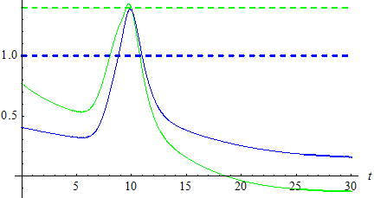
Two-T modeling.
n_{e}(t) , n_{h}(t) , n_{d}(t) T_{e} and T_{l}.
T_{e} shows a maximum,
then it decreases to meet
the growing T_{l}.
n_{e}
n_{e}
n_{h}
n_{h}
Δ_{h}
Δ_{e}
μ_{h} <Δ_{e} - always Boltzman gas.
μ_{e} >Δ_{e} (degenerate Fermi gas)
only temporarily; activated regime at longer t, with higher T.
It will become degenerate again after final cooling to ambient T.
μ_{e}
μ_{h}

Slide 22
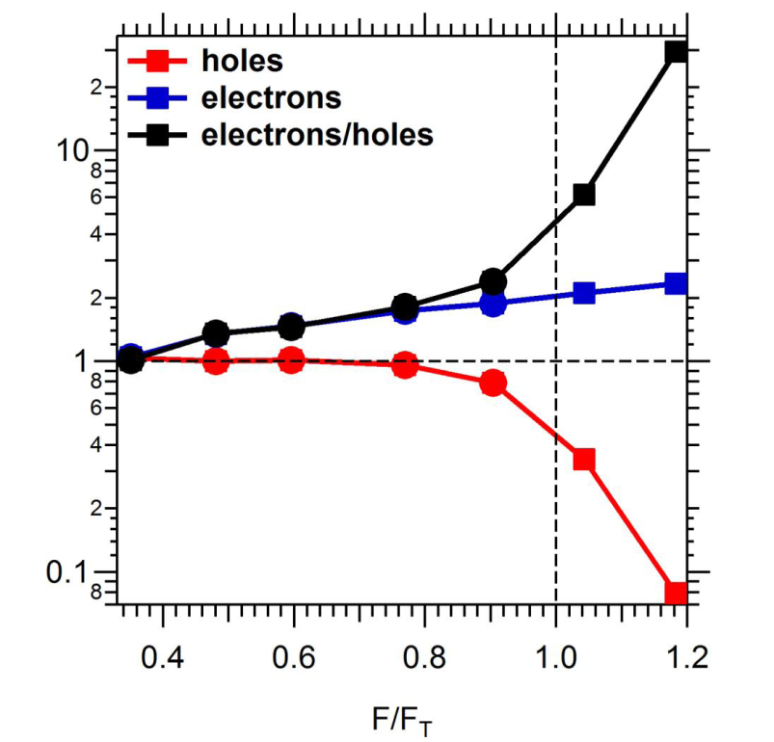
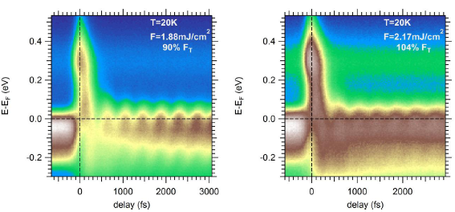
Patrick S Kirchmann
Stanford Institute for Materials and Energy Sciences
SLAC National Accelerator Laboratory
•e-h imbalance near threshold drives switching
•agrees qualitatively with phenomenological model by Serguei Brazovskii

Slide 23
Switching by voltage pulses.
Fast non-thermal current-induced switching between charge ordered many body quantum states in TaS2.
“Non-thermal switching between quantum states with different CDW order, including those not normally accessible under thermodynamic conditions, can be achieved with pulsed electrical charge injection.
The macroscopic nature of the states involved gives rise to unprecedented stability and remarkably sharp switching
thresholds.” D. Mihailovic group, Nat. Comm. 2016

Slide 24
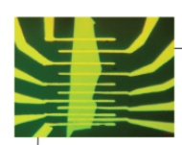
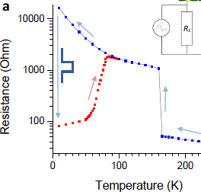
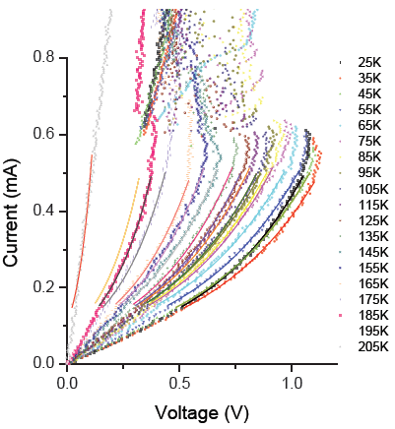
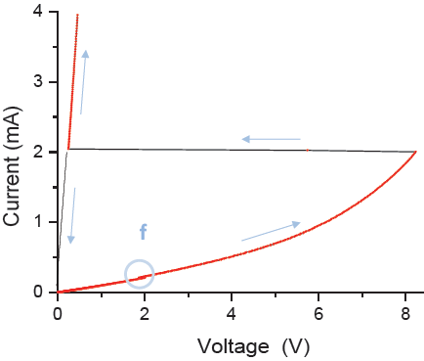

Slide 25
Theory attempt:
Instability towards stripe formation in 1T-TaS2 after charge injection.
A generic bistable system in between two contacts.
Commonly, a potential applied to a sample is expected
to concentrate the local charge density at the contacts
so that charge is screened.
In our special situation the charge penetrates into a bistable medium in which the competition of phases is controlled by the particle density n.

Slide 26
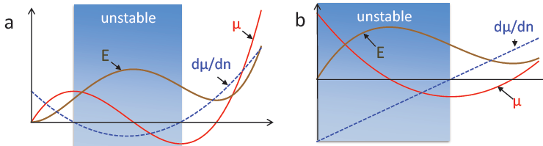

Thermodynamic functions as a function of n for bi-stable systems near the 1st order phase transition: free energy E (brown), chemical potential μ (red), its derivative k (blue-dashed).
a. The generic system. b: system with a C-NC transition.
principle difference of b) unlike a):
the energy 𝐸(𝑛) at small n has a cusp, it starts as 𝑊~𝑛 and then decreases.
The curve 𝑊(𝑛) is concave around the low n phase, and compressibility is negative
𝑘 = 𝑑𝜇/𝑑𝑛 < 0 for all n up to the inflection point of 𝑊(𝑛)
which lies between the barrier and the high n minimum.
Particularly for a charged system, this violation of the stability criterion means that the screening length square becomes negative:

Slide 27
𝑙_{𝑠𝑐𝑟} becomes imaginary. That leads to oscillations instead of the conventional
exponential decay with distance, resulting in phase separation and stripe formation.

Slide 28
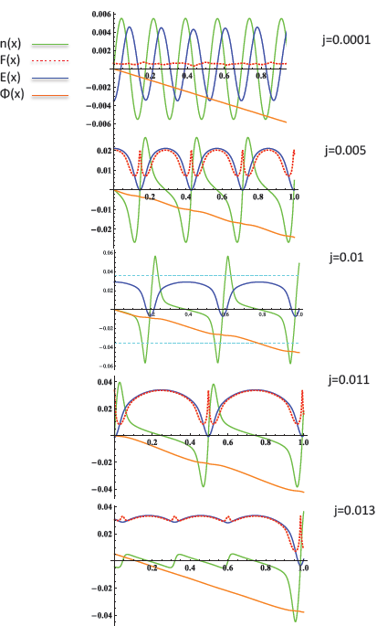
Undulations between “hole-doped” and “electron-doped” domains, 𝑛 > 0 and 𝑛 < 0.
Patterns evolve from a nearly sinusoidal shape to sharp domains whose number decreases progressively with increasing j, until the last strong one remains near the contact at 𝑥 =1
(𝑥 = 0 is the middle of the sample)
while the bulk is converted to a highly conducting state with smooth and weak undulations.
At low j, the period does not vary much with j
and stays close to the intrinsic value ∼ 2𝜋 𝑙_{𝑠𝑐𝑟} .

Slide 29

Remaining challenge:
Relate the global switching by both optics and voltage
with newest local manipulations by the STM

