Slide 1
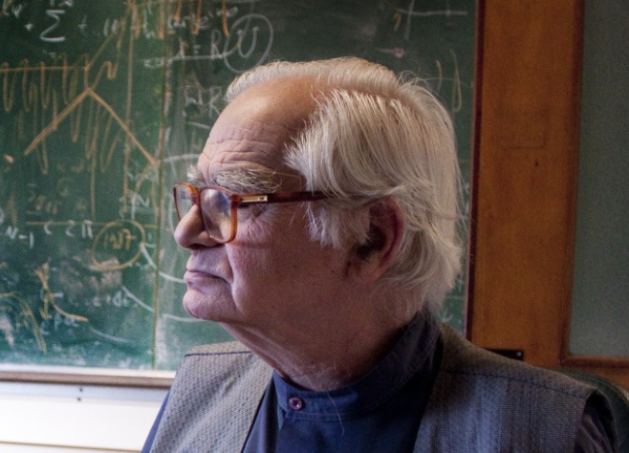

Photo : Jean-François Dars Anne Papillault

Slide 2
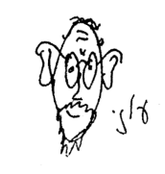


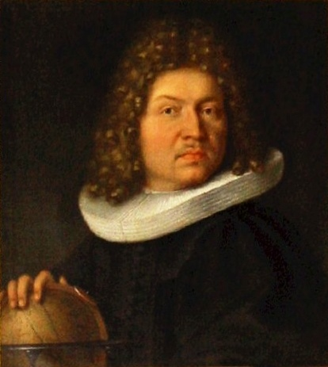
Bernoulli Random Matrix Ensembles
and
Random walks on Graphs
With Chris Joyner
In memory of Oriol, Paris March 2014
Jacob Bernoulli (1655 - 1705)
Abstract
The matrix elements of Bernoulli random matrices are chosen randomly from {0,1}, subject to some symmetry requirement and in some cases subject to global constraints. The extension to the Bernoulli case, of Dyson's Brownian motion model of Gaussian ensembles, will be discussed. This will be done by considering random walks on graphs which represent these ensembles.

Slide 3
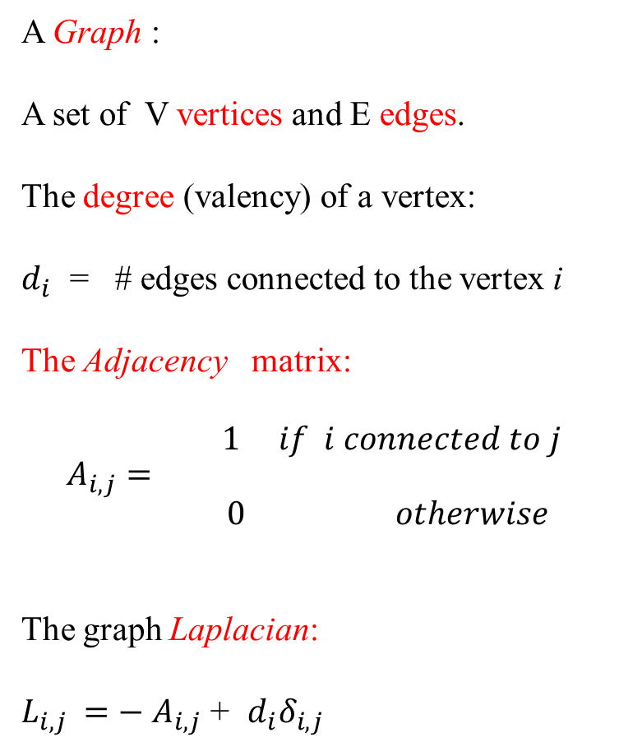
A Graph :
A set of V vertices and E edges.
The degree (valency) of a vertex:
$d_{i}$ = # edges connected to the vertex i
The Adjacency matrix:
$$A_{i,j}= \begin{matrix}\begin{aligned}1 if i connected to j \\ \end{aligned} \\ 0 otherwise \end{matrix}$$
The graph Laplacian:
$L_{i,j }{=− A}_{i,j}$ + $d_{i}δ_{i,j}$

Slide 4
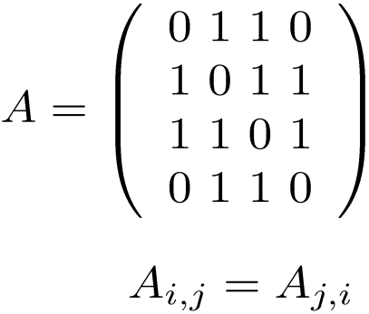
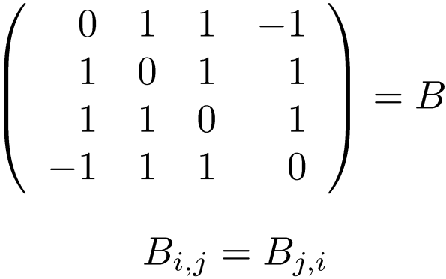
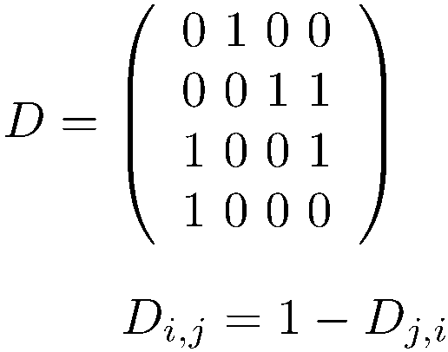
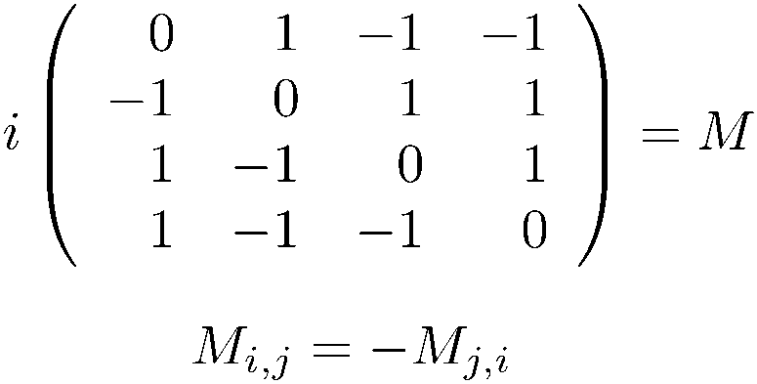
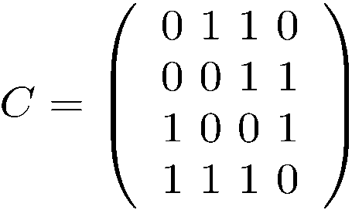
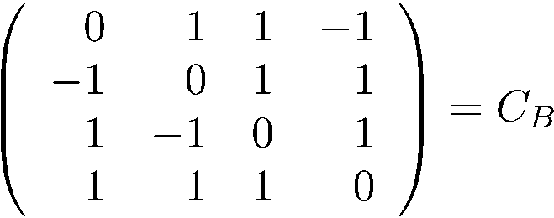
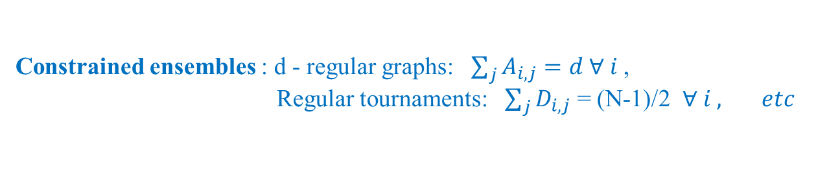
Graph ensembles as Bernoulli Matrix ensembles
1
2
Random graphs
3
4
1
2
Directed
random graphs
“Tournaments”
3
4
1
2
Partially directed
random graphs
3
4
Constrained ensembles : d - regular graphs: $\sum_{j}{A_{i,j}}=d ∀ i$,
Regular tournaments: $\sum_{j}{D_{i,j}}$ = (N-1)/2 $∀ i , etc$

Slide 5
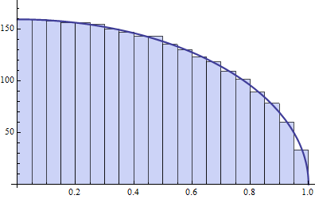
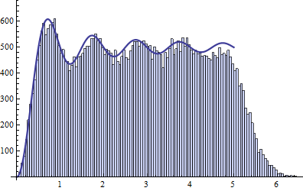
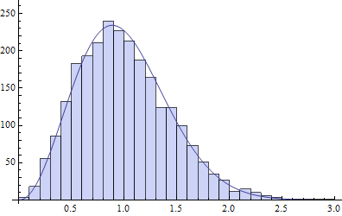
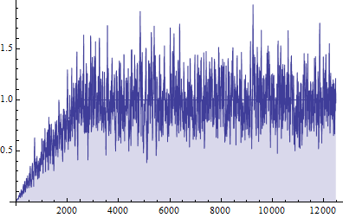
Numerical simulations : The spectral statistics of the Bernoulli ensembles in the large N limit
are reproduced by the corresponding Gaussian ensembles.
Example: tournaments
Smoothed spectral density
Gap spectral density
Spacings distribution
Form factor(smoothed)
The spectral statistics of unconstrained Bernoulli ensembles can be deduced from their Gaussian counterparts (Erdos, Yao,…). These methods do not apply for the constrained ensembles.
Purpose of this work: To present a discrete random walk model – analogous to Dyson’s
“Coulomb gas” which could apply for various Bernoulli
ensembles, with or without constraints.

Slide 6

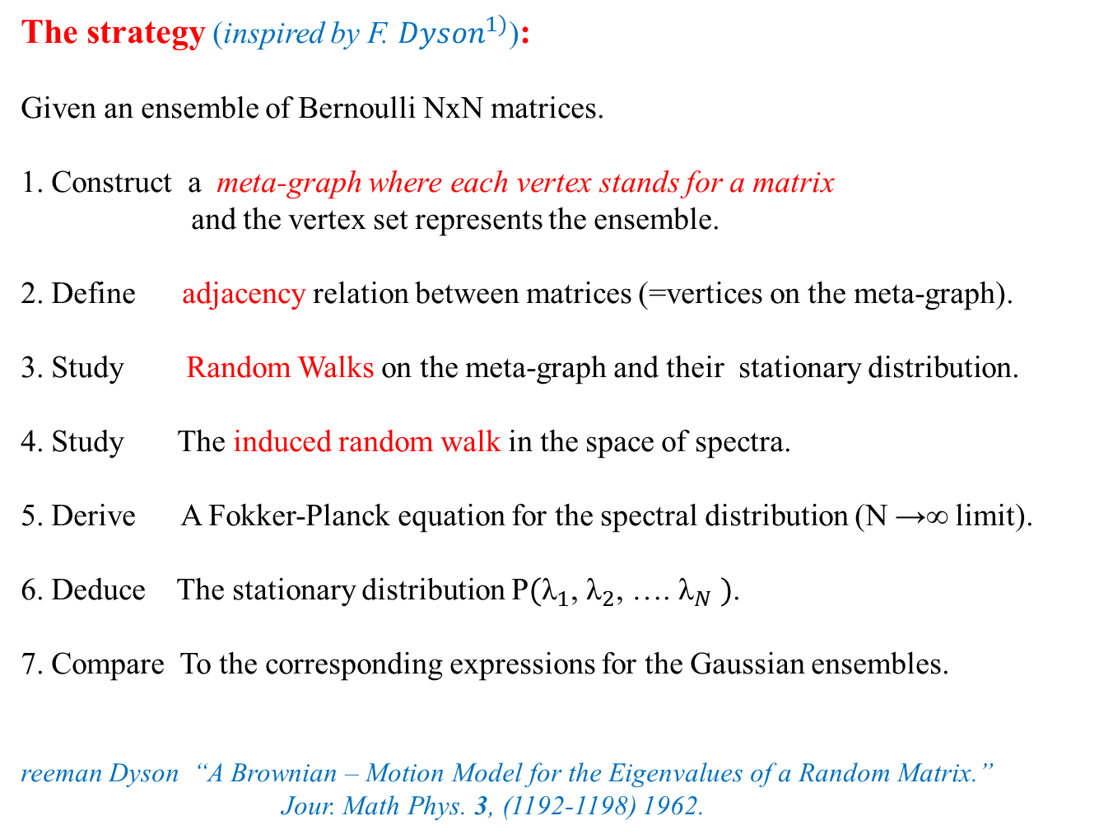
The strategy (inspired by F. ${Dyson}^{1)}$):
Given an ensemble of Bernoulli NxN matrices.
1. Construct a meta-graph where each vertex stands for a matrix
and the vertex set represents the ensemble.
2. Define adjacency relation between matrices (=vertices on the meta-graph).
3. Study Random Walks on the meta-graph and their stationary distribution.
4. Study The induced random walk in the space of spectra.
5. Derive A Fokker-Planck equation for the spectral distribution (N →∞ limit).
6. Deduce The stationary distribution P$({\text{λ}}_{1}$, ${\text{λ}}_{2}$, …. ${\text{λ}}_{N} )$.
7. Compare To the corresponding expressions for the Gaussian ensembles.
reeman Dyson “A Brownian – Motion Model for the Eigenvalues of a Random Matrix.”
Jour. Math Phys. 3, (1192-1198) 1962.
$${}_{}^{1)}F$$

Slide 7
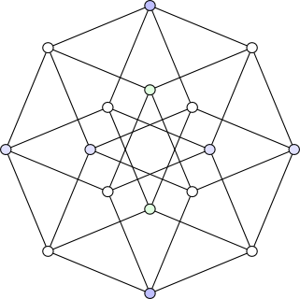

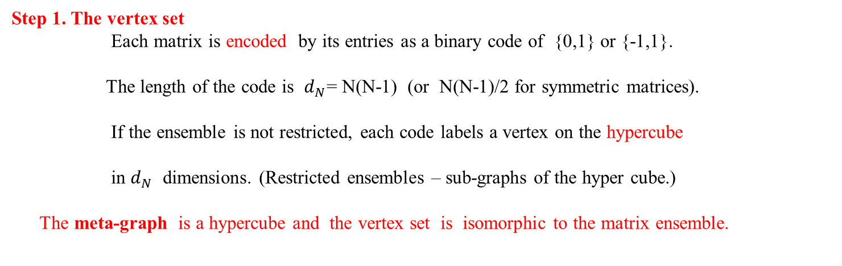
Step 1. The vertex set
Each matrix is encoded by its entries as a binary code of {0,1} or {-1,1}.
The length of the code is $d_{N}$= N(N-1) (or N(N-1)/2 for symmetric matrices).
If the ensemble is not restricted, each code labels a vertex on the hypercube
in $d_{N}$ dimensions. (Restricted ensembles – sub-graphs of the hyper cube.)
The meta-graph is a hypercube and the vertex set is isomorphic to the matrix ensemble.
V = $2^{d_{N}}$
(1,1,1,1)
(0,1,1,1)
(1,0,1,1)
(1,1,0,0)
(1,1,0,1)
(1,0,1,1)
(0,1,1,0)
(1,0,1,0)
(0,1,0,1)
(0,0,1,1)
(0,1,0,0)
(1,0,0,0)
(1,0,0,1)
(0,0,1,0)
(0,0,0,1)
(0,0,0,0)
The hypercube in 4 dimensions

Slide 8
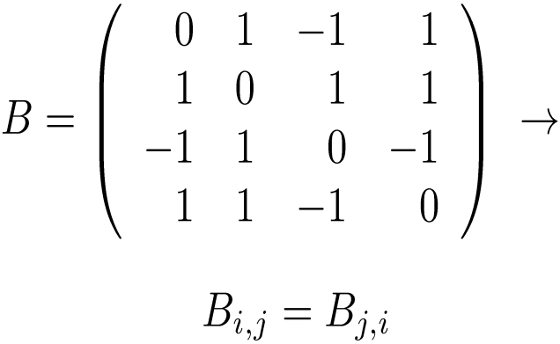
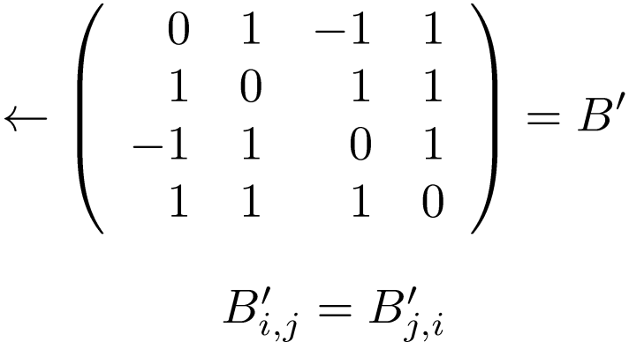
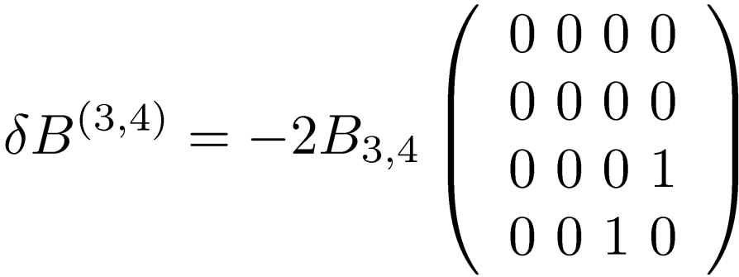
Step 2: Adjacency on the meta-graph
Example: Symmetric (sign balanced) Bernoulli with
Reminder: edge (i,j) is not connected if $B_{i,j}$= -1
1
2
1
2
~
3
4
3
4
Vertices are adjacent if the Hamming distance between them is 1
Every index in the original code can be interchanged to reach an adjacent vertex
on the meta graph. Hence, the meta-graph is regular with $d_{N}$ = (N-1)N/2.
δB=B’- B is a rank 2 perturbation

Slide 9
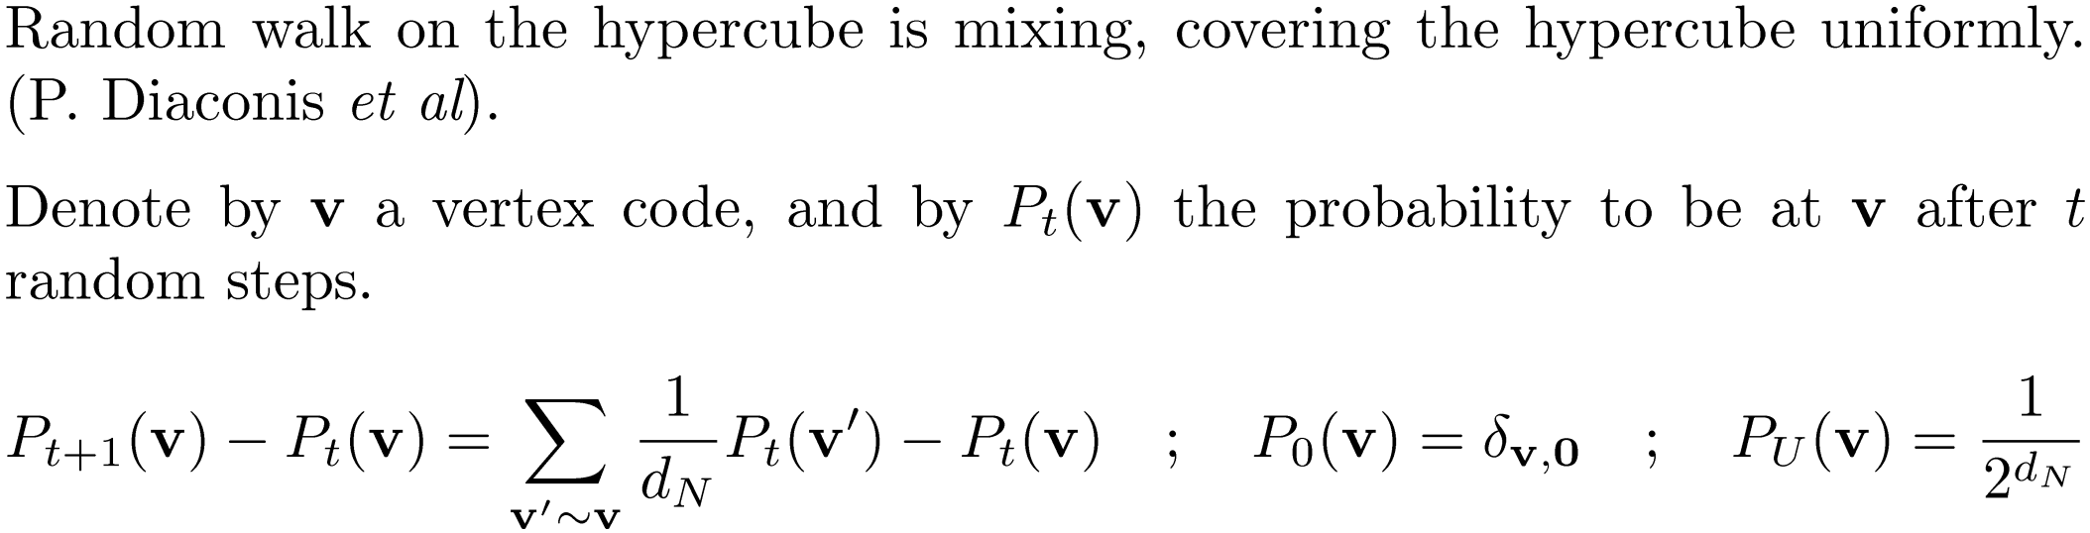
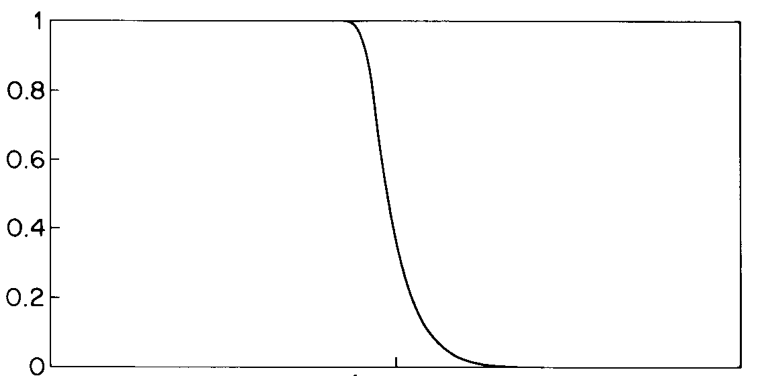

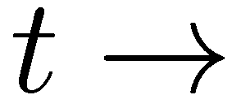

Step 3. Random walks on the meta-graph.
t = ¼ $d_{N}$ log $d_{N}$
( || || stands for the total variance. )

Slide 10
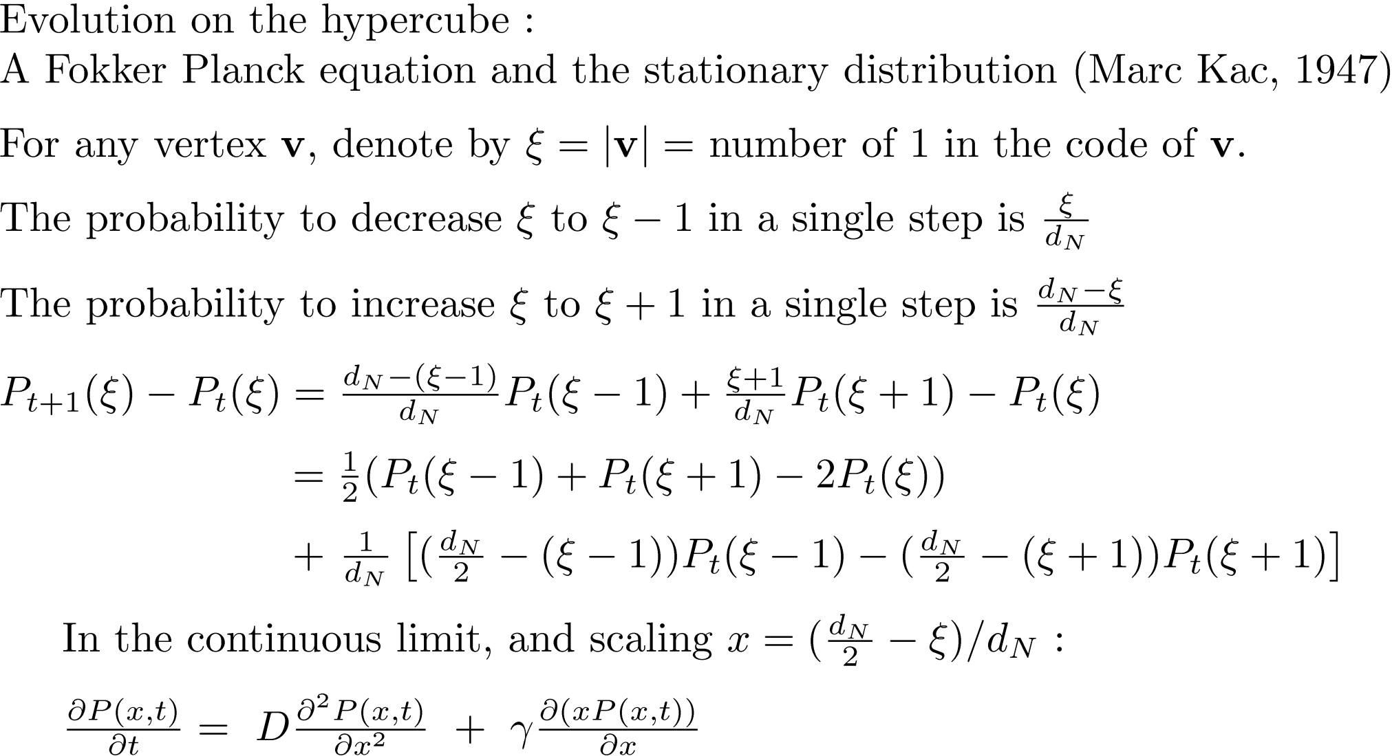
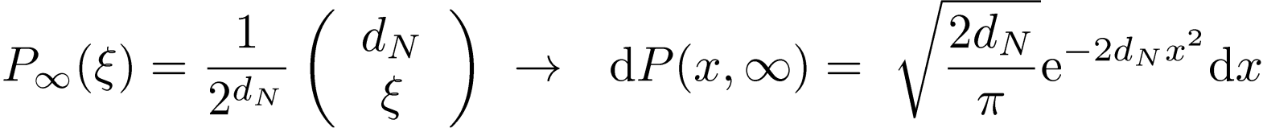
Diffusion
Drift
This is the Fokker Planck (Smoluchowski) equation for the Ornstein- Uhlenbeck process
describing a Brownian particle in a harmonic potential well.
Equilibrium is reached due to entropic rather than dynamical force.

Slide 11
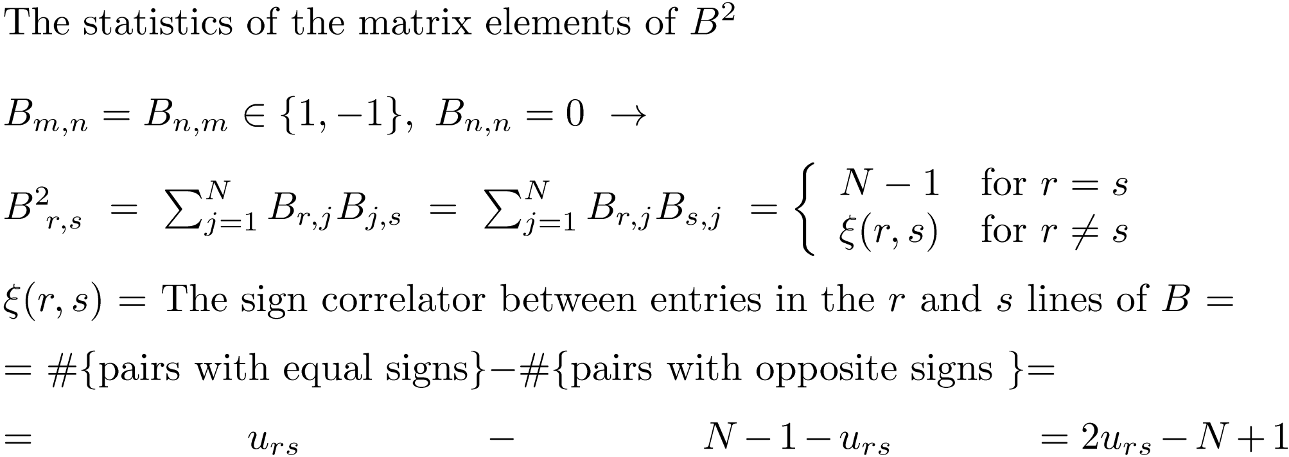
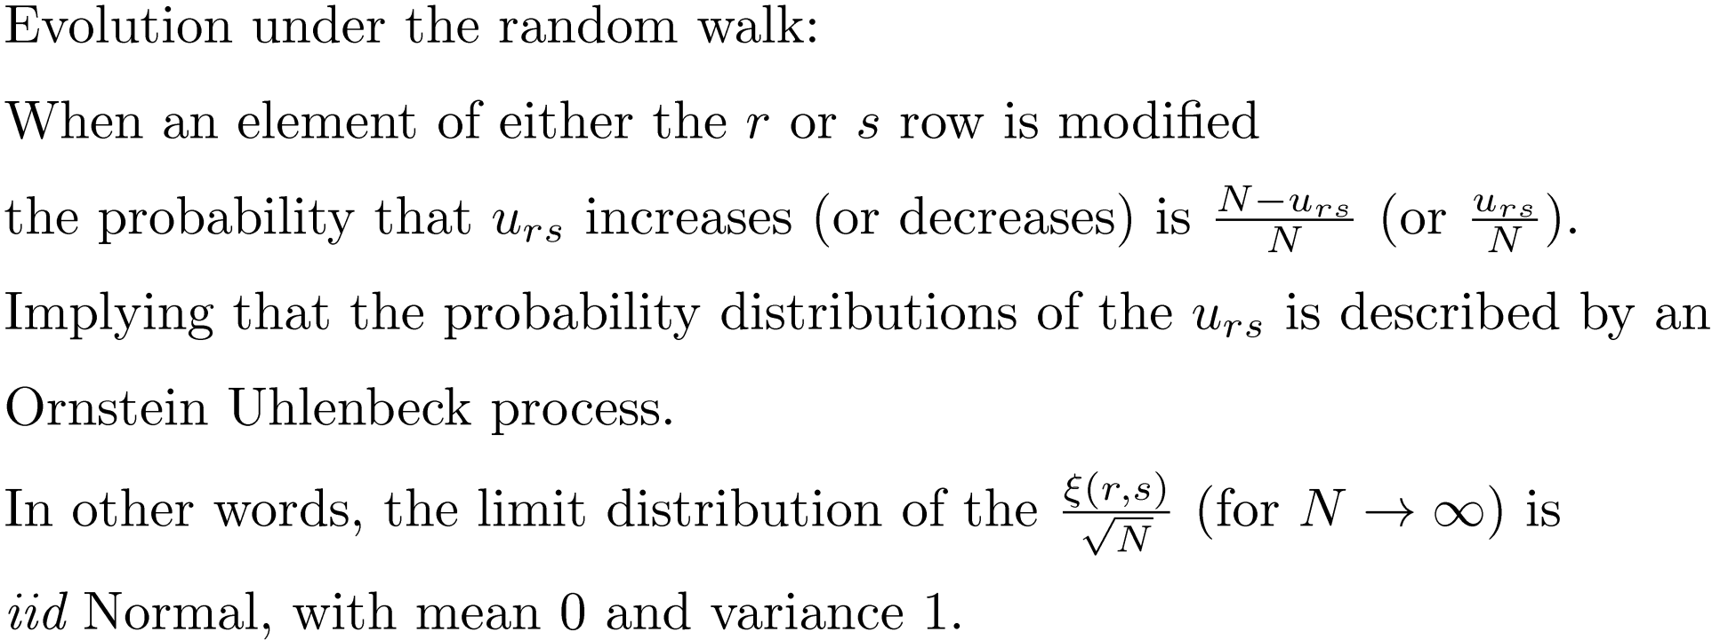

Slide 12
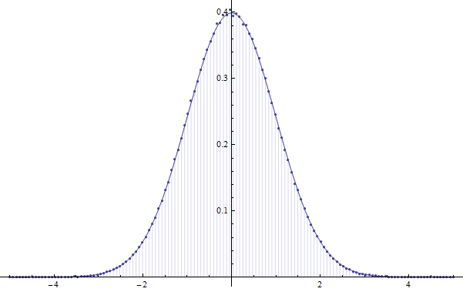
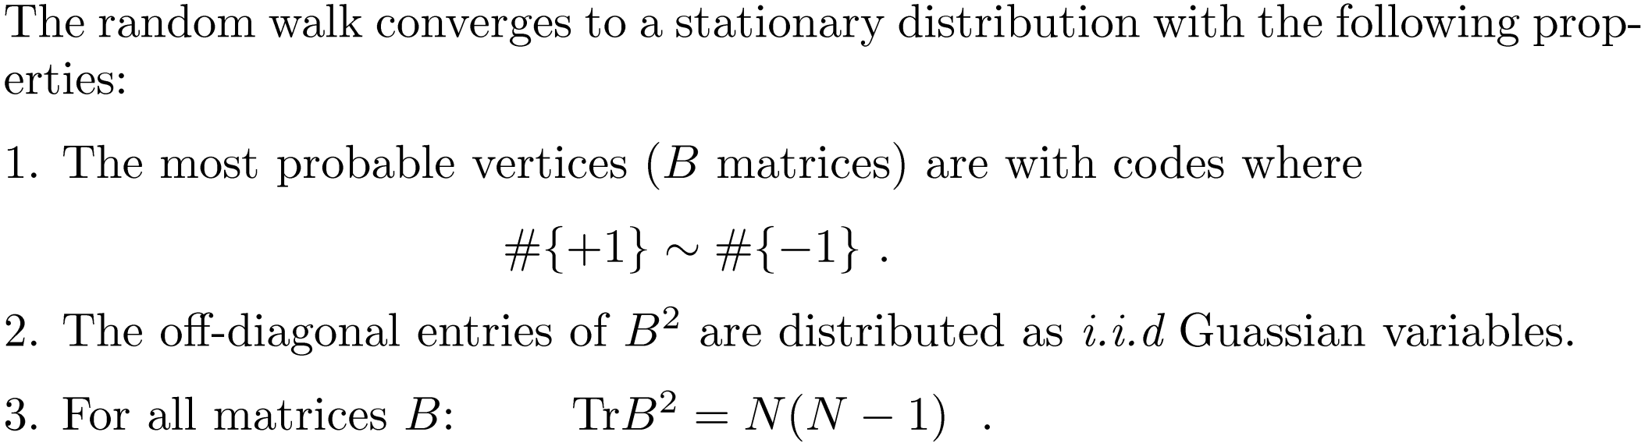
In summary:

Slide 13
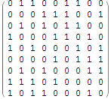
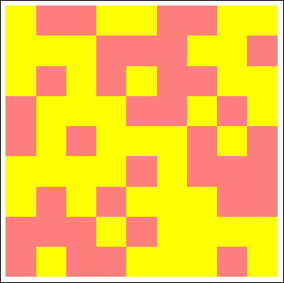
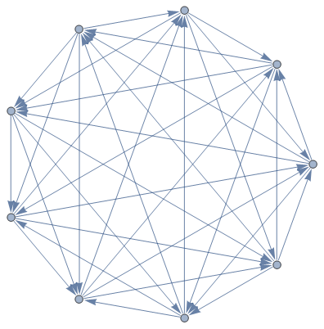
An illustration:
Regular Tournament:
A tournament where each player wins (and loses) exactly ½ the games. -> N odd.
D =
=
At each vertex:
# incoming edges = #outgoing edges

Slide 14


Invert blue triangle

Slide 15
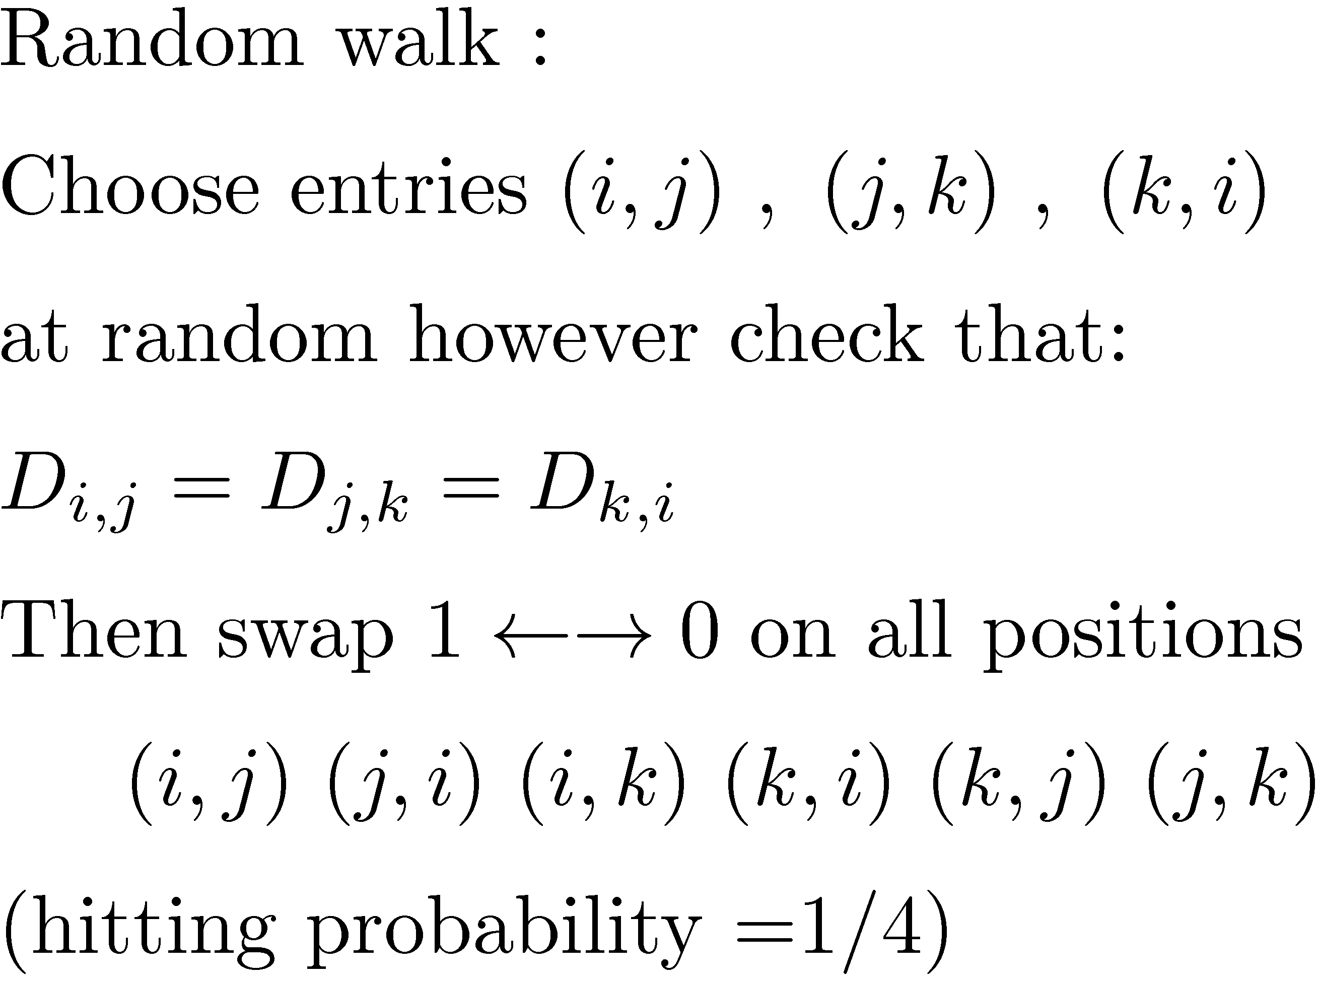
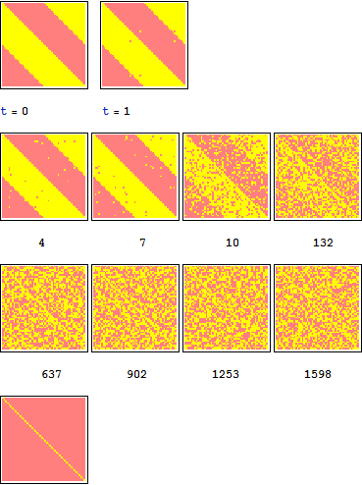

Generating random regular tournaments
D: 51x51

Slide 16
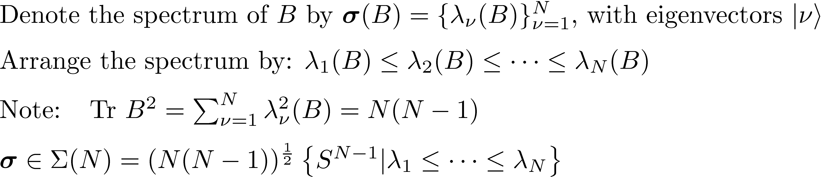
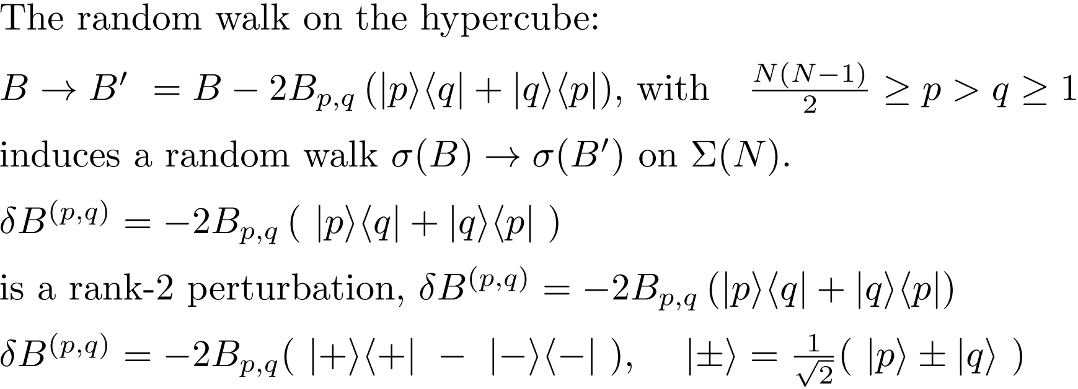
Step 4. Induced spectral random walks
At each vertex B of the meta-graph one computes the spectrum of B.
p

Slide 17
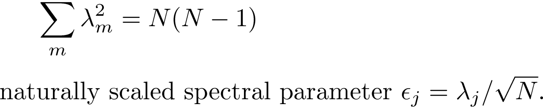
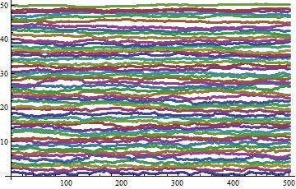
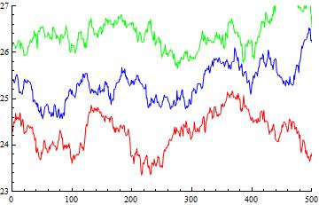
Spectral Random walks (Numerics)
N=101, A spectral random walk of 500 steps

Slide 19
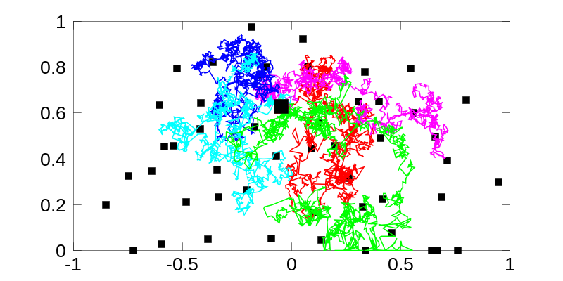
Complex eigenvalues of a 100 x 100 random {-1,1} matrix with no required symmetry
A trace of the random walk of a single eigenvalue over 10000 steps.
red, magenta, blue, cyan, green
Im[λ]
Re[λ]
Holger Schanz.

Slide 20
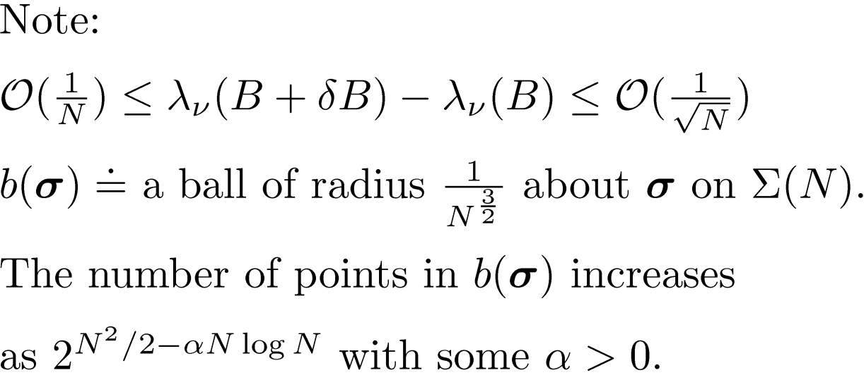
Step 5. Evolution of the coarse grained spectral distribution under the random walk

Slide 21
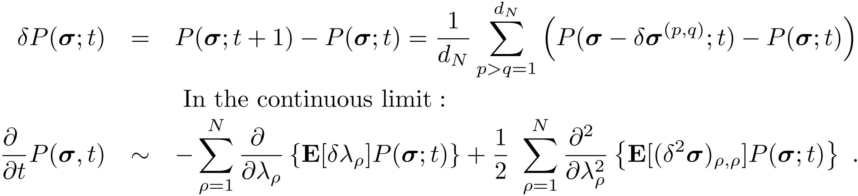
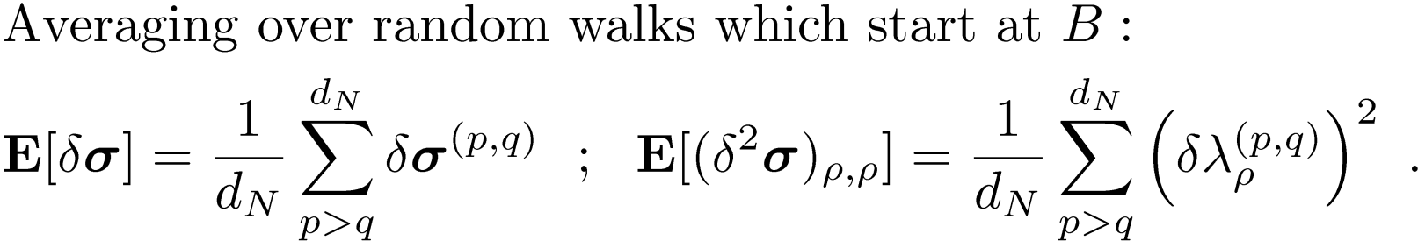
The underlying Markov process allows to write:
Drift Diffusion
A Fokker – Planck equation for the evolution of the spectrum
Mean drift
Variance

Slide 22
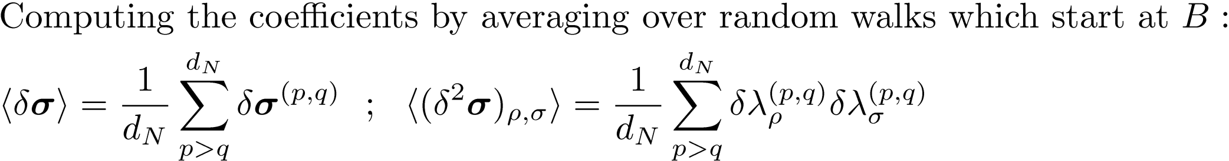
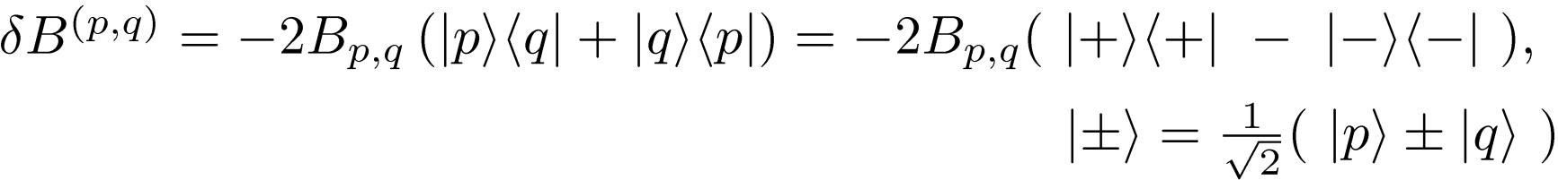











A positive rank 1 perturbation generates a positively shifted spectrum interlacing with the original
A negative rank 1 perturbation generates a negatively shifted spectrum interlacing with the original
Original spectrum
Shift right
Shift left
Total shift
$λ_{ r−1}≤$
$$λ_{ r−1} ≤$$
$${ λ}_{r }≤λ_{r } ≤$$
$$λ_{ r+1}≤$$
$$λ_{ r+1}$$
$λ_{ r−1}≤$
$$λ_{ r−1} ≤$$
$${ λ}_{r }≤λ_{r } ≤$$
$$λ_{ r+1}≤$$
$$λ_{ r+1}$$
$${ λ}_{r }≤$$
$$λ_{ r+1}$$
$$λ_{ r−1} ≤$$
Which explains why the total shift cannot exceed one level spacing in either direction.

Slide 23
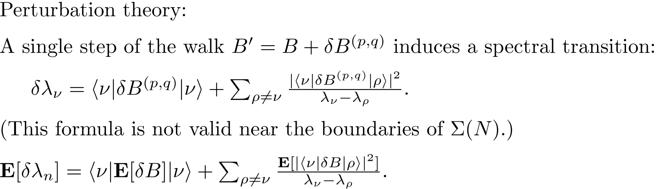
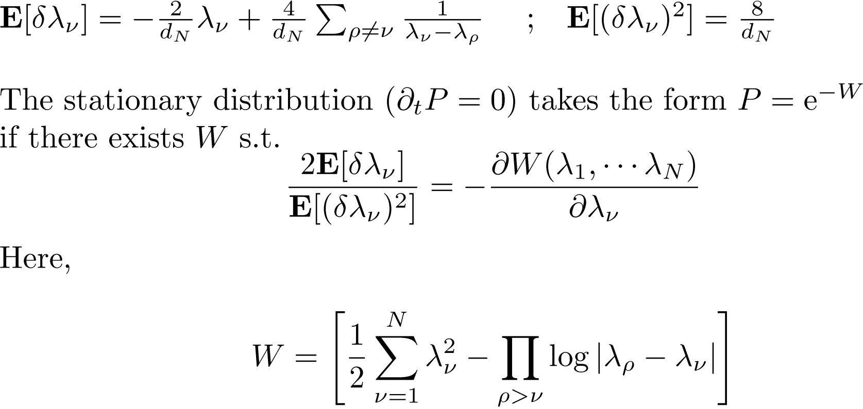

Slide 24
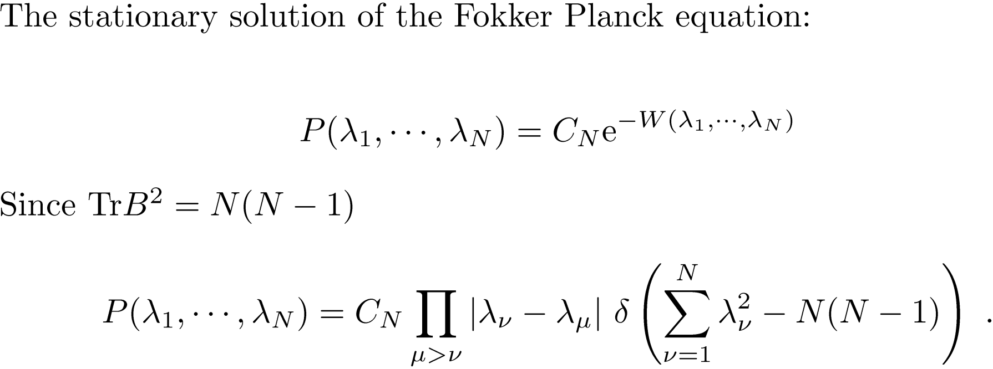
6. Deduce The stationary distribution P$({\text{λ}}_{1}$, ${\text{λ}}_{2}$, …. ${\text{λ}}_{N} )$.
7. Compare To the corresponding expressions for the Gaussian ensembles.
This is the probability distribution function for the fixed trace GOE ensemble.
It is known to display the semi-circle law (and Tracy Widom statistics) as well as
k point correlations of the unrestricted GOE.
(e.g, F. Goetze and M. Gordin: Limit correlation functions for fixed trace random matrix ensembles .
Comm. Math. Phys. 215, 683-706 (2008))

Slide 25
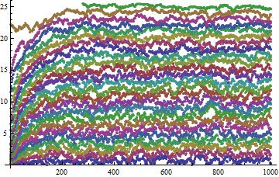


Illustration (cont)
The random walk in the ensemble of regular tournaments
Induces spectral dynamics with a rank 2 perturbation
per random step.

Slide 26








281584
28257
nmax = 1501
# of attempted
triangles 1125750
94007
843334

Slide 27



Spectral statistics
Numerical results for a single tournament
Spectral density
Spacing distribution
Form factor
(smoothed)
nmax = 1500
Spectral points in the support 749
Scrambling 843334 iterations

Slide 28


Summary: 1 The derivation above is not entirely rigorous.
2. The same method applies with some minor modifications for the
unrestricted ensembles (Tournaments, {0,1} matrices).
3. The eigenvectors distributions are not derived or assumed.
4. Work on the restricted ensembles (d-regular, regular tournaments)
is in progress. (With Chris Joyner)
Thank you for your attention

